Slide 1
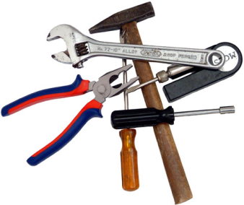
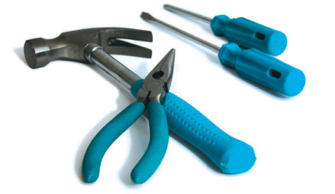
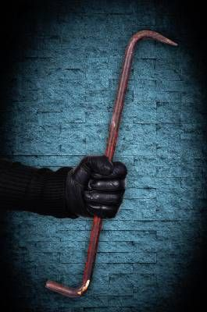
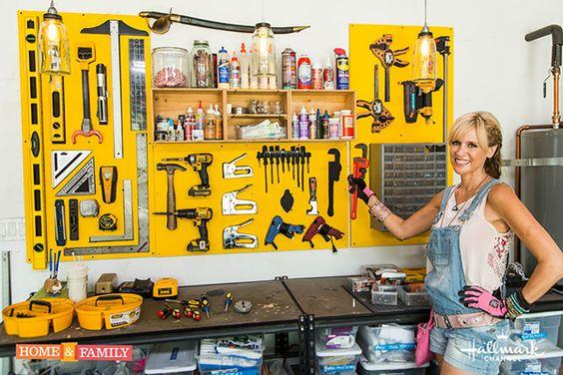
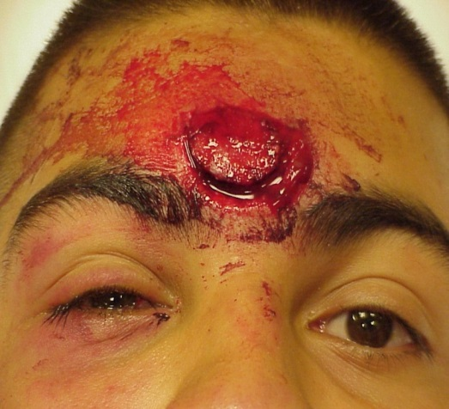
TOOL MARKS
1
Forensic Science: Fundamentals & Investigations, Chapter 16

Slide 2
Chapter 16 Tool Marks By the end of this chapter you will be able to:
Describe the three major types of tool mark impressions
Summarize the steps of a tool mark examination and analysis
Explain how technology is helping in criminal investigations
Match tool marks with the instrument that produced them
All Rights Reserved South-Western / Cengage Learning © 2009
2
Forensic Science: Fundamentals & Investigations, Chapter 16

Slide 3
What is a Tool Mark?
A tool mark is considered to be any impression, cut, scratch, gouge, or abrasion caused by a tool coming into contact with another object.
For example, if you attempted to pry open a locked window with a screwdriver, the screwdriver would leave a tool mark on the window and windowsill.
3

Slide 4
Introduction
A tool mark is any impression, abrasion, or cut made when contact occurs between a tool and an object.
Tool marks are a good example of physical evidence formed at a crime scene.
Mass-produced tools have minor differences that can differentiate one tool from another.
The impressions made by these tools could link the tool to a crime scene and ultimately to the owner.
4
Forensic Science: Fundamentals & Investigations, Chapter 16

Slide 5
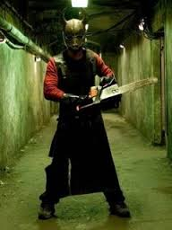
Tools and Crime Scenes
Tools increase our ability to handle manual tasks.
Tools that help people everyday can also be used in crimes.
How can a tool used in a crime lead investigators to the criminal?
Why is ownership of a tool used in a crime circumstantial evidence?
5
Forensic Science: Fundamentals & Investigations, Chapter 16

Slide 6
Usually Involve Forcible Entry
Most often, tool marks are encountered at burglary scenes that involve forcible entry into a building or safe.
Typically, an indented impression is left on the frame of a door or window as a result of the prying action of a screwdriver or crowbar.
One of the first things an investigator looks for at a suspect’s home is the suspect’s toolbox.
Any tools in the commission of a crime leave unique scratch marks behind.
These striation marks can be used to match a tool to an object it came into contact with at the crime scene.
6

Slide 7
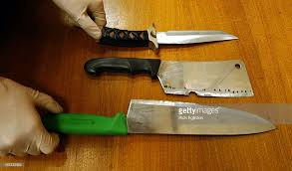
A careful examination of these impressions can reveal important class characteristics. . .
That is, the size and shape of the tool.
However, they rarely reveal any significant individual characteristics that could permit the examiner to individualize the mark to a single tool.
Such characteristics, when they do exist, usually take the form of discernible random nicks and breaks that the tool has acquired through wear and use.
7

Slide 8
Microscopic Irregularities
Just as the machined surfaces of a firearm are impressed with random striations during its manufacture, the edges of a pry bar, chisel, screwdriver, knife, and cutting tool will likewise display a series of microscopic irregularities having the appearance of ridges and valleys.
8

Slide 9
The Machining Process Can Make a Tool unique
Such markings are left as a result of the machining processes used to cut and finish tools.
These markings are called striation marks.
The shape and pattern of such minute imperfections are further modified by damage and wear during the life of the tool.
When a screwdriver is first made, the microscopic imperfections in the blade make it unique.
As it is used, more imperfections are added and the blade becomes more unique.
9

Slide 10
Imperfections Cause Individuality
Considering the unending variety of patterns that the hills and valleys can assume, it is highly unlikely that any two tools will be identical.
Hence, it is the presence of these minute imperfections that imparts individuality to each tool.
10

Slide 11
Tool Mark Impressions
Tools usually leave behind distinctive marks where they are used.
There are there categories of tool marks:
Indentations marks
abrasion marks
cutting marks
11
Forensic Science: Fundamentals & Investigations, Chapter 16

Slide 12
Tool Mark Impressions
Abrasion Marks
They are made when surfaces slide across on another.
An object’s surface can be ground or worn away by a tool.
It is the harder object that will cause abrasions on the softer surface.
Indentation and abrasion marks sometimes are made at the same time.
12
Forensic Science: Fundamentals & Investigations, Chapter 16

Slide 13
Tool Mark Impressions
Indentation Marks
They are impressions made by a tool when it is pressed against a softer surface.
Tools usually leave distinctive marks where they are used.
The hardness of a tool influences the resulting marks left in the softer object.
Indentation marks are made when a tool is pressed against a softer surface.
The impression may indicate information such as the size of the tool used in a crime.
13
Forensic Science: Fundamentals & Investigations, Chapter 16

Slide 14
Tool Mark Impressions
Cut Marks
These are produced along the edge as a surface is cut.
If they are hard enough, edged instruments can penetrate a softer object and separate it into parts.
Cut marks are produced along the edge as a surface is cut.
Hack saws, for example, leave chopping marks on a surface of contact.
14
Forensic Science: Fundamentals & Investigations, Chapter 16

Slide 15
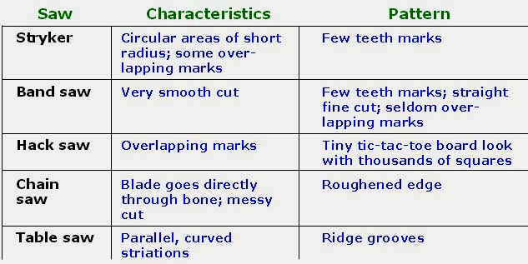
Tool Mark Impressions
Cut Marks—examples of cut marks on bones
Cut marks made by various tools have been cataloged.
15
Forensic Science: Fundamentals & Investigations, Chapter 16

Slide 16
Tool Mark Examination
When a crime scene contains tool mark evidence, if the investigator is not trained in this type of evidence collection, tool mark experts can be called in.
Evidence can include tool marks at the scene as well as the tool if it is left at the scene.
16
Forensic Science: Fundamentals & Investigations, Chapter 16

Slide 17
Documenting the Evidence
If possible, tool mark evidence is collected.
If it is not possible, castings can preserve impressions of the tool marks.
The cast impression will retain the unique indentation marks made by a specific tool.
A variety of silicone or rubber-based casting materials can be used to record impression marks.
17
Forensic Science: Fundamentals & Investigations, Chapter 16

Slide 18
Documenting the Evidence
Surfaces should be examined before casting material is applied to determine if the area should be dusted for fingerprints.
The use of magnetic dusting powder and silicone material allows for fingerprints to be lifted from the surface before impression marks are cast.
The size of the impression should be measured and recorded.
18
Forensic Science: Fundamentals & Investigations, Chapter 16

Slide 19
Collecting and Preserving a Sample
Correctly label evidence.
Wrap small objects with clean paper and place them in small containers or plastic bags.
Pack large objects in cartons or boxes.
Record who collected the evidence, where it was found, when it was found, and why the evidence was collected.
Maintain the chain of custody.
19
Forensic Science: Fundamentals & Investigations, Chapter 16

Slide 20
Analyzing Tool Mark Evidence
Laboratory tool mark analysis aims to identify:
major characteristics defining the type of tool used in a crime.
unique characteristics that might distinguish between the same kinds of tools.
Forensic comparison microscopes are used to further examine tool mark characteristics that match a suspect tool.
20
Forensic Science: Fundamentals & Investigations, Chapter 16

Slide 21
New Technology in Tool Mark Identification
In court, visual pattern comparisons are not enough.
Tool mark databases (with images acquired by forensic comparison microscopes) are being built.
Algorithms to statistically analyze tool mark patterns are being developed.
Scanning tools are being used to measure the depth or height of tool marks.
21
Forensic Science: Fundamentals & Investigations, Chapter 16

Slide 22
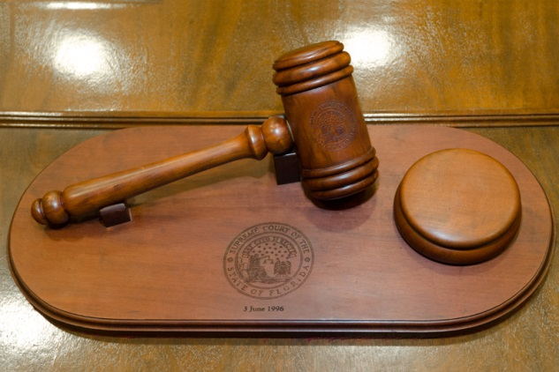
Tool Mark Evidence in the Courtroom
The tool mark witness prepares a written report to present to a jury.
Whenever possible, original evidence is presented in court.
Often, castings and magnified images of tool mark comparisons are presented at trial.
Such evidence may be used to link a series of crimes.
22
Forensic Science: Fundamentals & Investigations, Chapter 16

Slide 23
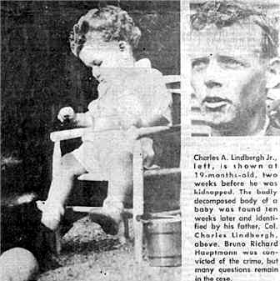
The Lindbergh Baby Kidnapping
In 1932 the infant son of Charles and Ann Lindbergh was kidnapped from his nursery. A handmade wooden ladder used to gain entrance to a second-floor window, a ransom note, some muddy footprints, and a chisel were the only clues left at the crime scene.
23

Slide 24
The Lindbergh Baby Kidnapping
The ransom was paid, but the infant was never returned.
His body was eventually found in the woods near the Lindbergh home.
A suspect, Richard Hauptmann, was eventually arrested.
One of the first things forensic investigator, Arthur Koehler looked for was Richard Hauptmann’s toolbox. . .

Slide 25
In it he found . . .
The hand plane used to construct the homemade ladder.
The imperfections in the plane’s blade caused unique striation marks on any wood it was used on.
Test pieces of wood planed with this tool displayed the same striation marks found on the wooden ladder left at the Lindbergh home.
This proved that Richard Hauptmann’s plane was used to make the ladder used in the kidnapping.
The wood used to make the ladder used in the infants kidnapping was also matched to Richard Hauptmann’s attic.

Slide 26
. . . . . . . . . . . . . . . . . Summary
Tools have major and minor surface differences.
Tool marks are indentations, abrasions, or cut marks.
Impressions made by tools could link them to a crime scene and ultimately to the owner.
Tool mark evidence should be photographed, documented, and collected or cast.
26
Forensic Science: Fundamentals & Investigations, Chapter 16

