Slide 1
Infectious Disease
Chapter 40

Slide 2
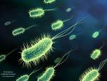
Pathogens
Disease causing organisms are called pathogens.
Microorganisms like bacteria, viruses, and many protozoans are pathogens.
Typically they cause disease when they attack our cells or produce chemical (toxins) that interfere with normal cellular activity.

Slide 3
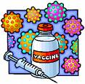
Controlling Disease
Vaccines, antibiotics, sterilization, disinfectants are all common ways of controlling disease.
Viruses cannot be treated with antibiotics and must be prevented with vaccines.
Controlling disease is another example
of homeostasis in organisms.

Slide 4
Disease
A disease is a non-injury change that disrupts the normal functioning of the body.
In addition to pathogens, environmental factors (smoking ) and genetic factors (hemophilia can cause disease.

Slide 5
The Germ Theory of Disease
The first people to realize that some diseases were caused by microorganisms (germs theory of disease) were Louis Pasteur and Robert Koch.
Robert Koch devised several rules (postulates) to determine of a microorganism caused a disease.

Slide 6
Koch’s Postulates
The pathogen is found in a sick organism but not a healthy one.
The pathogen must be grown in the lab (cultured)
Cultured pathogens can cause disease when placed inside a new host.
The pathogen can be isolated from the second host.

Slide 7
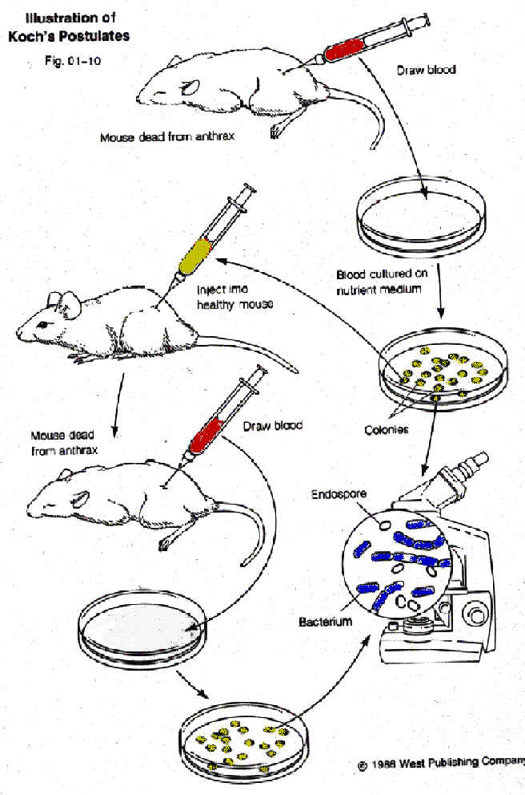

Slide 8
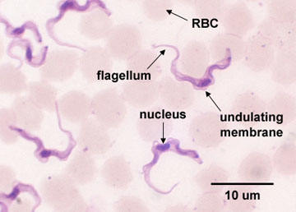
Spread of Disease
Diseases are spread commonly through
Physical contact
Consuming contaminated food and water
Coming in contact with vectors.
African sleeping sickness carried by the tsetse fly.

Slide 9
The Immune System
The function of the immune system is to fight infection through the production of cells that inactivate foreign substances or cells.
There are two general defense mechanisms against infection: nonspecific defenses and specific defenses.

Slide 10
Nonspecific Defenses
Attempt to prevent disease form entering the body.
Examples include your skin, mucus, salvia, tears, and some enzymes.

Slide 11
Nonspecific Defenses
The inflammatory response is a nonspecific response to tissue damage caused by injury or infection. White blood cells are sent to the infection site by the millions causing swelling and pain. The white blood cells phagocytize bacteria.
A fever is an attempt by your body to raise the body temperature to a point where pathogens are killed.
Interferons are proteins produced by the body to attack viruses.

Slide 12
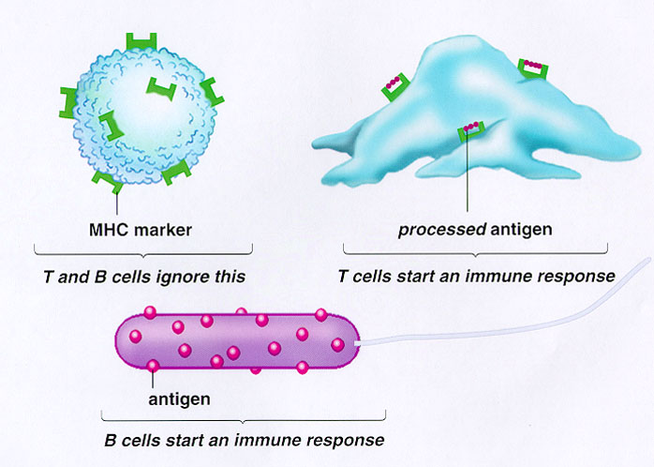
Specific Defenses
When organisms are able to get past the body’s nonspecific defenses an immune response is initiated.
Any substance that triggers an immune response is called an antigen.

Slide 13
Specific Defenses
There are two types of cells in your body that recognize antigens.
B-cell provide immunity within the body fluids (humoral immunity).
When they contact an antigen they increase in number and produce plasma cells and memory B-cells.
Plasma cells release antibodies which attack the antigen.
The memory B-cells reduce the chance of a repeat infection by reducing the amount of time needed for all of this to occur.

Slide 14
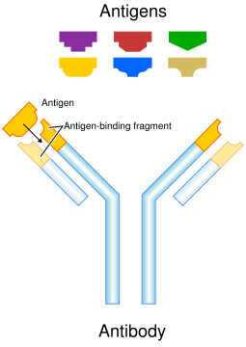
Antibodies have the following shape:

Slide 15
Specific Defenses
T-cells provide immunity within the cell (cell-mediated immunity). When a disease is detected the T-cells divide into:
Killer T-cells: track down and destroy the antigen
Helper T-cells: produce memory T-cells
Suppressor T-cells: shut down the killer T-cells once the infection is under control
Memory T-cells: prevent secondary infections.

Slide 16
Acquired Immunity
Active immunity occurs when the body is stimulated through vaccines to create plasma cells. It tends to last a long time and can also occur naturally.
Passive immunity occurs when antigens produced by other organisms are used to fight infection in humans. This is typically short-lived and is one of the advantages of breast feeding.

Slide 17
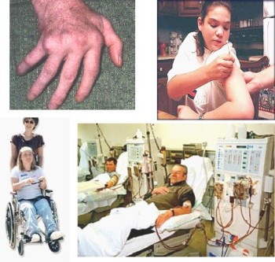
Immune System Disorders
Allergies, autoimmune diseases, and immunodeficiency diseases are all disorders associated with the immune system.

Slide 18
Immune System Disorders
Allergies are by far the most common and can be caused by pollen, dust, mold, and bee stings.
Allergy causing antigens cause the release of histamines which cause an increase in blood flow and increase mucus production in the respiratory system (sneezing, watery eyes, running nose).

Slide 19
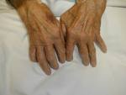
Immune System Disorders
Asthma is a severe example when the air passages become so narrow breathing becomes difficult.
Autoimmune diseases occur when the immune system attacks the body’s normal cells. Some forms of arthritis and diabetes are examples.

Slide 20
Immune System Disorders
AIDS is the best example of an immunodeficiency disease.
The virus (HIV) attacks T-cells preventing them from performing their immunological duties.
Individuals become susceptible to opportunistic infections that typically lead to death.
There is no known cure but can be treated.

Slide 21
AIDS
At rick behaviors include:
Sexual intercourse with infected person
Sharing needles or syringes with infected people
Contact with the blood of an infected person
Infected mother passing it to a child during pregnancy or breast feeding.

Slide 22
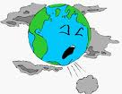
The Environment and Your Health
A risk factor is anything that increases the chance of disease or injury.
Environmental risk factors include air and water quality, wastes in landfills, and solar radiation
Some gases found in air can be risk factors including carbon monoxide, ozone, and small particles (particulates) like dust, pollen, spores, mites, asbestos, and lead.

Slide 23
Environment and Health
Water quality is affected by both biological (bacteria, viruses) and chemical contaminants.
Cancers occur when cells multiply uncontrollably causing a mass of cells known as a tumor. These cells typically use the nutrients needed by other cells or prevent cells or organs from functioning properly
Chemicals that cause cancers are called carcinogens.
The best way to prevent cancers is to protect yourself from carcinogens with the proper diet and exercise.

