Slide 1
Chapter 10
Handwriting Analysis, Forgery, and Counterfeiting

Slide 2
By the end of this chapter you will be able to:
Describe 12 types of handwriting characteristics
that can be analyzed in a document
Demonstrate an example of each of the 3 types of handwriting traits
Identify the major goal of a forensic handwriting analysis
Distinguish between the terms forgery and fraudulence
Identify several ways that businesses prevent check forgery
Describe 4 features of paper currency that are used to detect counterfeit bills

Slide 3
Introduction
Document Analysis – the examination and comparison of questioned documents with known material.

Slide 4
Questioned Document – a signature, handwriting, printing, or other written mark whose source or authenticity is in dispute or uncertain.
Examples
Checks
Certificates
Wills
Passports
Licenses
Money
Letters
Contracts
Suicide notes,
Receipts

Slide 5
Document Expert – specially trained person who scientifically analyzes handwriting and other features in a document
Examines written notes and compares various traits.
Graphologist – person who studies the personality of the writer based on samples.
Not a scientific analysis
Can indicate writer's personality type

Slide 6
Examine and compare questioned documents with known material
Field investigations include:
Handwriting
Computer printouts
Commercial printing
Paper and ink
Threatening, ransom, or suicide notes
Analysis helps identify a document’s author

Slide 7
History of Forensic Handwriting Analysis
1930s—handwriting analysis played a role in the famous Charles Lindbergh child kidnapping case.
1999—the US Court of Appeals determined that handwriting analysis qualifies as a form of expert testimony

Slide 8
To be admissible in court, scientifically accepted guidelines must be followed
Scotland Yard, the FBI, and the Secret Service use handwriting analysis
Determines a match between known material (known as an exemplar) and a questioned document.

Slide 9
Introduction to Handwriting
Everyone’s handwriting exhibits natural variation based on several factors:
Type of writing instrument (pen, pencil, marker, etc.)
Mood
Age
How hurried we are
Despite variation, each person has a unique handwriting style
Writing subconsciously, characters are formed from habit

Slide 10
The traits are functions of formatting or of letter or line form.

Slide 11
Handwriting Examination
Two writings came from one person if:
their similarities are unique and
no unexplainable difference(s) are found
Examine the questionable document for detectable traits and record them.
Obtain a known sample of the suspect’s writing (an exemplar).
Compare and draw conclusions about the authorship of the questionable document.

Slide 12
Exemplar best examples:
letters
Diaries
Greeting cards
Personal notes
It’s helpful if the exemplar contains some of the same words/phrases as the document in question.
Forgeries are documents made, adapted, or falsified with the intention of deceiving someone.

Slide 13
To minimize conscious writing for exemplars:
Don’t show the suspect the document in question
Don’t give the suspect instructions on punctuation or spelling
Pen and paper should be similar to questioned document

Slide 14
Technology used in handwriting analysis:
Biometric Signature Pads
“Learns” to recognize how a person signs
Evaluates speed, pressure, and rhythm of the signature
Recognizes forgeries by the detection of even slight differences
Computerized Analysis
Compares handwriting samples objectively
Compared with samples stored in databases
Infrared Spectroscopy
Can determine ink type

Slide 15
Handwriting
Evidence in the Courtroom
Expert explains how comparisons were made
Cross-examination by defense attorney may follow
Shortcomings in Analysis
Are the base documents real or fake?
Did mood, age, fatigue impact the handwriting?
Did experts miss details any details?

Slide 16
Forgery
Forged documents include:
checks
employment records
legal agreements
licenses
wills
Fraudulence—forgery for material gain

Slide 17
Check forgery can include:
ordering another’s checks from a deposit slip
altering a check
intercepting another’s check, altering, and cashing it
creating a check from scratch

Slide 18
Check Forgery
Americans write 70 billion checks per year – approximately $27 million illegitimate checks are cashed each day.
Check forgery can include:
ordering another’s checks from a deposit slip
altering a check
intercepting another’s check, altering, and cashing it
creating a check from scratch

Slide 19
Preventing Check Forgery
Chemically sensitive paper
Large font size requires more ink and makes alterations more difficult
High resolution borders that are difficult to copy
Multiple color patterns
Embed fibers that glow under different light
Use chemical wash detection systems that change color when a check is altered

Slide 20
Literary Forgery
Forgery of a piece of writing such as a historic letter or manuscript is literary forgery.
Best forgeries aim to duplicate the materials found in the original:
old paper
chemically treated materials to fake an older look
inks mixed from substances that would have been used at the time
watermarks that add the appearance of age
tools and styles that would have been popular at the time

Slide 21
Counterfeiting
When false documents or other items are copied for the purpose of deception, it is called counterfeiting.
A criminal activity existing since antiquity
Items commonly forged today include:
Currency
Traveler’s checks
Food stamps
Certain bonds
Postage stamps

Slide 22
Counterfeit Currency
Security features are added to paper currency that scanning cannot reproduce
Regular printer paper contains starch; Paper currency contains rag fiber instead of starch.
Number one reason people suspect fakes is because it doesn’t feel right.

Slide 23
Currency is always being redesigned to make it more difficult to counterfeit.
New bills:
$20 – October 9, 2003
$50 – September 28, 2004
$10 – March 2, 2006
$5 – Early 2008

Slide 24
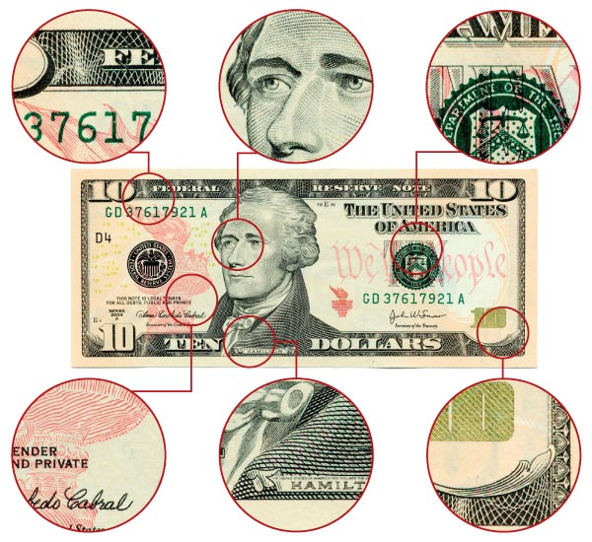
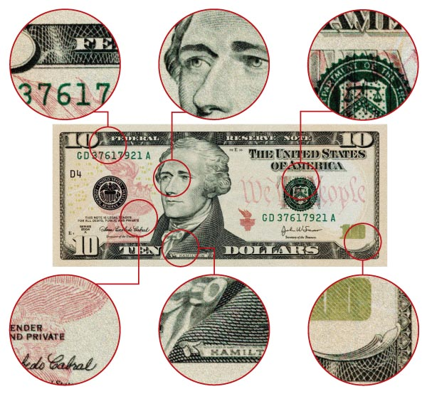
Authentic vs. Counterfeit
The tiny, intricate lines and details on paper money do not always print well in counterfeit bills.

Slide 25
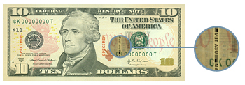
Verifying Authentic Currency
New Security Features:
Portrait stands out and appears raised off the paper
Contains clear red and blue fibers woven throughout the bill
Has clear, distinct border edges
Treasury seal is shown with clear, sharp saw-tooth points
Watermark appears on the right side of the bill in the light

Slide 26
The security thread is evident—a thin embedded vertical strip with the denomination of the bill printed in it
There is minute printing on the security threads, as well as around the portrait
When the bill is tilted, the number in the lower right-hand corner makes a color shift from copper to green

Slide 27
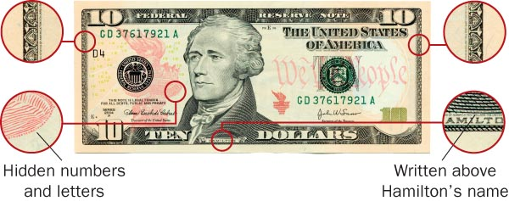
Examples of Security Features

Slide 28
Summary
Handwriting analysis compares questioned documents with exemplars to establish authorship.
Aspects of a person’s handwriting style can be analyzed to ascertain authenticity.
Many new features of paper currency help prevent counterfeiting.
Technological advances have enhanced chances of detecting forged documents.

