Slide 1
Forensics of Soil

Slide 2
Soil Composition
Soils are made of four main components:
mineral matter (40 - 60 %)
soil water (20 - 50 %)
soil air (0 - 40 %) The soil pore space is filled either by soil water or soil air
Mostly nitrogen, oxygen and carbon dioxide
organic material (small percentage).

Slide 3
Forensic Soil Tests
Soil Density (measured as bulk density)
Soil Texture
Soil characterization: soil presence of carbonates, soil color, relative amount of living material, structure type, general appearance of the soil, soil structure
Amount of nutrients (nitrogen, potassium, phosphorous)
Microscopic examination of soil

Slide 4
Soil Forensics
The transfer of soil trace evidence is governed by what has become known as the Locard Exchange Principle
When two surfaces come into physical contact there is a mutual exchange of trace evidence between them

Slide 5
Soil Forensics
The United States Department of Agriculture, which collects soil data at many different scales, state there were more than 21,000 soil series identified in the United States alone

Slide 6
Soil Forensics
Soil evidence must be recognized on questioned items and subsequently at known proposed crime scenes and alibi localities
Evidence must be well documented.
Meticulous collection and preservation of soil samples must be maintained so as to ensure the integrity of the soil evidence
Soil characterization is done

Slide 7
What makes soil a useful item for trace evidence?
Soil is highly individualistic in that there are an almost infinite number of different soil types
Soils may change rapidly over very short distances both horizontally and vertically
Ability to distinguish between soil samples
Soil materials are easily described and characterized by color and by using various analytical methods such as XRD (mineralogy) and spectroscopy (chemistry)

Slide 8
What makes soil a useful item for trace evidence?
Soil has a strong capacity to transfer and stick, especially the fine clay- and silt-size fractions
Soil materials are easily located and collected using hand lenses or light microscopes
National and international computerized databases of soil profile data and maps can be readily accessed by police or soil scientists through the Internet

Slide 9
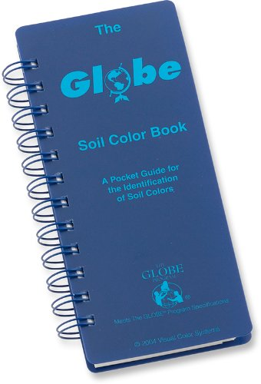
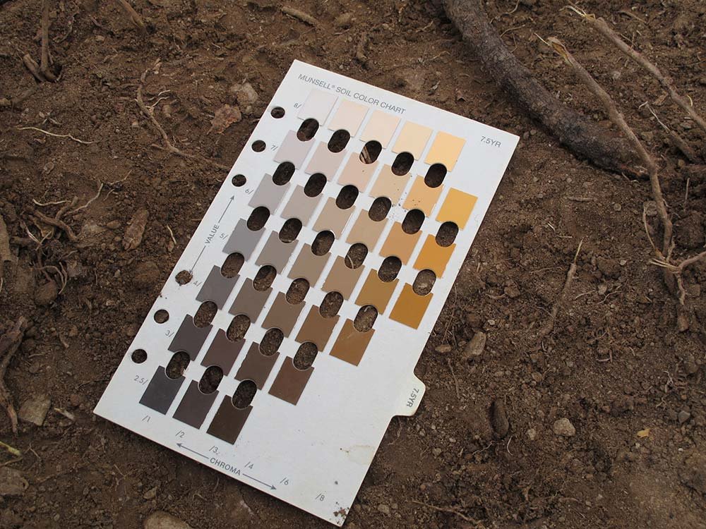
Soil Color

Slide 10
Soil Color
Is affected by the mineral content, amount of decayed material, parent material.
As rocks containing iron or manganese weather, the elements oxidize forming small crystals with a yellow or red color
Organic matter decomposes into black humus
Using a soil color chart, you are looking at hue (color), intensity and value (lightness or darkness)

Slide 11
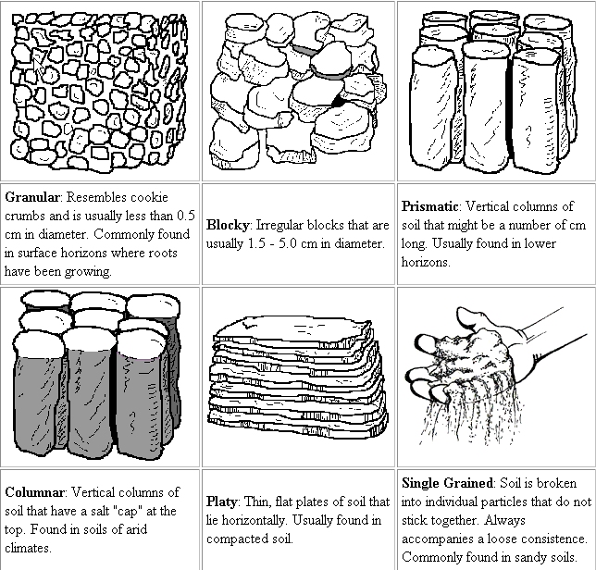
Structure Type of Peds

Slide 12
Structure Type
There is also what is called structureless, where there is no shape to the peds.

Slide 13
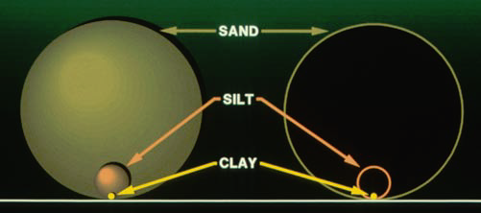
Soil Texture

Slide 14
Soil Texture
Texture is determined according to the relative
proportions of sand, silt, and clay in the soil
-Sand, the larger size of particles, feels gritty
-Silt, moderate in size, has a smooth or floury texture
-Clay, the smaller size of particles, feels sticky.
Use soil texture chart to name soil texture

Slide 15
Relative Size of Particles
Table of Size of Sand, Silt and Clay
Name | Particle Diameter
Clay | below 0.002 millimeters
Silt | 0.002 to 0.05 millimeters
Very fine sand Fine sand Medium sand Coarse sand Very coarse sand | 0.05 to 0.10 millimeters 0.10 to 0.25 millimeters 0.25 to 0.5 millimeters 0.5 to 1.0 millimeters 1.0 to 2.0 millimeters
Gravel | 2.0 to 75.0 millimeters

Slide 16
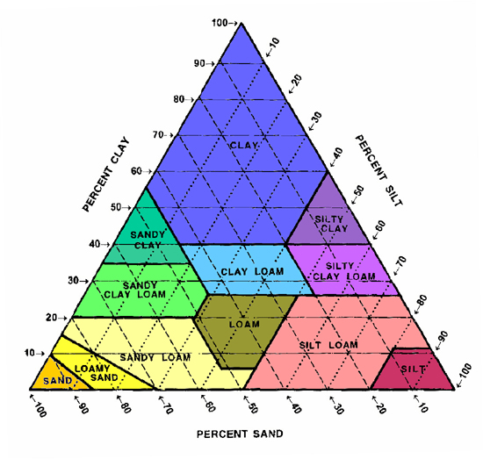
Soil Texture

Slide 17
Soil pH
Soil pH is a measure of soil acidity or alkalinity.
It is an important indicator of soil health
Natural soil pH reflects the combined effects of soil-forming factors:
parent material,
Time
relief or topography
climate
organisms

Slide 18
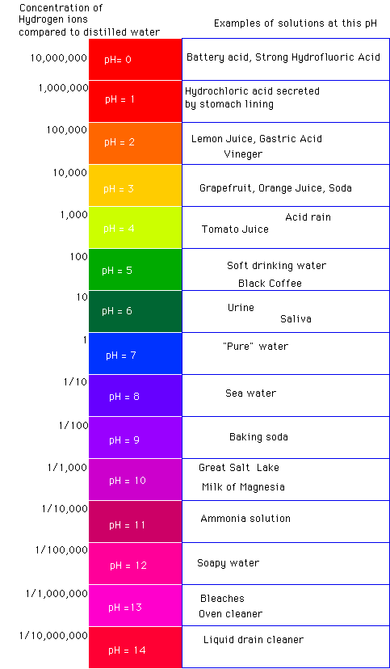
Soil pH
pH is potential hydrogen in water solution
Acidity – Soil pH is less than 7.
Alkalinity – Soil pH is greater than 7.
Soil pH level is highly variable
depending on field location and time of year

Slide 19
pH
Each level of pH is 10 times the level below
A pH of 4 is 10 times more than a pH of 3
A pH of 7 is 100 times more potential hydrogen than a pH of 5.
Low pH corresponds to high hydrogen ion concentration
Buffers act to resist changes in pH
Most plants grow well in soils of pH of 6 to 6.8

Slide 20
Soil pH is Affected by Land Use and Management.
Soils with high clay and organic matter content are more able to resist a drop or rise in pH (have a greater buffering capacity) than sandy soils.
Areas of forestland tend to be more acidic than areas of grassland

Slide 21
Forensics and pH
pH can be affected by the oils on your skin
You must wear gloves when performing pH tests
When testing for pH it is wise to do several tests for accuracy
pH is measured using litmus paper, pH paper or pH meter

Slide 22
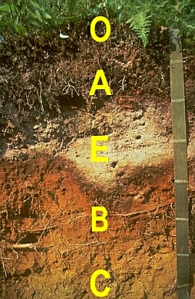
Soil Profile
A soil profile is a vertical view of the layers of soil from the surface down to the unaltered parent material, and is used in classifying soils.

Slide 23
Soil Profile- Names of Layers
O Horizon - The top, organic layer of soil, mostly of leaf litter and humus (decomposed organic matter). A Horizon - topsoil; it is found below the O horizon and above the E horizon. Seeds germinate and plant roots grow in this dark-colored layer. It is made up of humus mixed with mineral particles. E Horizon - This eluviation (leaching) layer is light in color; this layer is beneath the A Horizon and above the B Horizon. It is made up mostly of sand and silt, having lost most of its minerals and clay as water drips through the soil (in the process of eluviation). B Horizon - Also called the subsoil - this layer is beneath the E Horizon and above the C Horizon. It contains clay and mineral deposits (like iron, aluminum oxides, and calcium carbonate) that it receives from layers above it when mineralized water drips from the soil above. C Horizon - Also called regolith: the layer beneath the B Horizon and above the R Horizon. It consists of slightly broken-up bedrock. Plant roots do not penetrate into this layer; very little organic material is found in this layer. R Horizon - The unweathered rock (bedrock) layer that is beneath all the other layers (not shown in soil profile to the left

Slide 24
Soil Classification
Soils are classified based on the climate where found as have similar materials
Climate factors, type of biome will affect the characteristic of the soil (dry versus rainy; temperate forest versus desert)

Slide 25
Soil Order | Characterisitics
Alfisols | develop in humid and subhumid climates, frequently under forest vegetation, slightly to moderately acid
Andisols | over 60 % volcanic (ash, cinder, pumice, basalt), low density, Dark A horizon, very high cation exchange capacity
Aridisols | exist in dry climates, salty layers
Entisols | no profile development, river floodplains, volcanic ash deposits and sands
Histosols | organic soils (peat and mucks) from swamps, bogs and marshes
Inceptisols | have weak to moderated horizon development due to cold, water loged soils
Mollisols | frequently under grassland, Deep, dark A horizons, lime accumulation
Oxisols | excessively weathered, are in tropical and subtropical climates, low fertility
Spodosols | Coniferous forest soils, sandy, leached soils strongly acid profiles, well-leached E horizons
Ultisols | extensively weathered soils of tropical and subtropical climates, strongly acid, Thick A horizon
Vertisols | Found in temperate to tropical climated with distinct wet and dry seasons, high content of clays that swell when wetted and show cracks when dry

Slide 26
Soil Orders Map
Soil Orders Map

Slide 27
Bulk Density
Bulk density is an indicator of soil compaction
The dry bulk density of a soil is inversely related to the porosity of the same soil
The more pore space, the lower the bulk density
soils rich in organic matter have lower bulk density
Test is performed by extracting a large soil sample in a standard size can.

Slide 28
Soil Fertility
Plants require macronutrients of nitrogen, phosphorous, and potassium to grow
Soils can become depleted by leaching of minerals due to water or large uptake of a certain mineral by plants

Slide 29
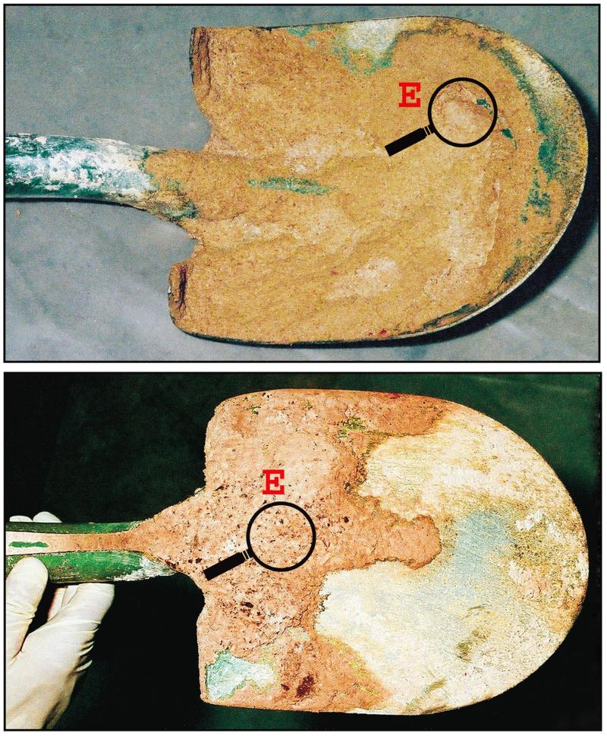
Forensics-Solving the Case
Once all the tests are performed, the forensic scientist makes a judgment as to the comparability category between samples

