Slide 1
Wednesday 3/21
Starter: NEW SEATS
Get your notebook Organized. Then start reading the article!
Stamping: NA
Pick up: 4 papers
Homework: N/A
Pg | Left | Pg | Right
32 | Starters | 33 | TOC
34 | 9 secrets of medical examiners | 35 | Death, Dying, Entomology notes

Slide 2
9 Secrets of Coroners and Medical Examiners…
What is the main difference between a medical examiner and a coroner?
What is a Legal Death Investigator?
What is a thanatologist?
How are medical examiners just “doctors doing doctor work?”
Why would medical examiners need to call in specialists in other fields of forensics?

Slide 3
9 Secrets of Coroners and Medical Examiners…
What is the main difference between a medical examiner and a coroner?
What is a Legal Death Investigator?
What is a thanatologist?
How are medical examiners just “doctors doing doctor work?”
Why would medical examiners need to call in specialists in other fields of forensics?

Slide 4
9 Secrets of Coroners and Medical Examiners…
6. How are medical examiners an “advocate for the dead”?
7. Why must medical examiners be careful at a crime scene as well?
8. What are some differences between the way MEs really are and how they are portrayed on TV?
9. How do MEs also work with the living?
10. What does Herick mean when he says “death informs their outlook on life”?

Slide 5
Death and Decomposition

Slide 6
What will we cover in this section?
Distinguish between the five manners of death: natural, accidental, homicidal, suicidal, undetermined
Use evidence or rigor, algor, and livor mortis to calculate the approximate time of death
Describe the stages of decomposition of a corpse
Explain how time of death can be estimated using insect evidence
Describe how various environmental factors may influence estimated time of death

Slide 7
Vocabulary
Algor mortis – The cooling of the body after death
Autolysis – The spontaneous break-down of cells as they self-digest
Cause of death – The immediate reaction for a person’s death (i.e. heart attack)
Death – The cessation, or end, of life
Decomposition – the process of rotting and breaking down

Slide 8
Vocabulary
6. Forensic Entomology – the study of insects as they pertain to legal issues
Livor Mortis – the pooling of blood in tissues after death resulting in a reddish color of the skin
Manner of Death – one of four means by which someone dies (natural, etc.)
Mechanism of Death – the specific body failure that leads to death
Rigor Mortis – the stiffening of skeletal muscles after death

Slide 9
Manner of Death
Natural – interruption and failure of body functions resulting from age or disease
i.e. – heart failure, cancer
Accidental – caused by unplanned events
i.e. – car accidents, falling from a ladder
Suicide – person purposefully kill oneself
i.e – hanging, drug overdose, gunshot
Homicide – death of one person caused by another person
Undetermined – listed as the official cause when cause cannot be determined

Slide 10
Manner of Death
A man with a heart condition is attacked and dies from a heart attack during the assault.
accident, natural or homicide?
An elderly woman dies after being kept from receiving proper health care by her son.
accident, natural, or homicide?

Slide 11
Manner of Death
In both cases it is…… HOMICIDE!!!
But, can you prove it in court????

Slide 12
Cause and Mechanism
Cause of Death – disease, injury, stroke, heart attack
Homicide – shooting, burning, drowning, strangulation, etc.
Mechanism of Death – specific change that brought about death
If cause is shooting – loss of blood, ceasing of brain function
If cause is heart attack – pulmonary arrest (stops beating)

Slide 13
Cause and Mechanism
“massive trauma to the body leading to pulmonary arrest”
Cause?
Mechanism?

Slide 14
How long after death does…
Livor mortis?
Rigor mortis?
Algor mortis?
It is ALWAYS important to record surrounding temps, environment, clothing, wind, sun, etc to use when calculating time of death!

Slide 15
Livor Mortis
Means “death color”
Begins two hours after death occurs
2-8 hours after death – push area of body and color will disappear
More than 8 hours after death – color will remain
Temperature has an effect
Cooler temp – occurs slower
Warmer temp – occurs faster

Slide 16
Graphic picture alert!

Slide 17
Livor Mortis

Slide 18
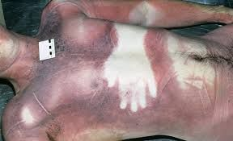
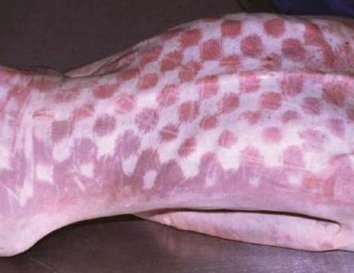

Slide 19
Livor Mortis
Can tell you what position a body was in the first 8 hours after death
Blood pooled at face, chest – body face down
Blood pooled at back, buttocks, back of head – body face up
What if blood is pooled in lower legs and feet, lower arms and hands?
Can also tell if the body was moved
Dual lividity (pooling of blood)
Occurs if person left in killed position at least 2 hours and then moved before lividity is permanent
Very common in homicide victims

Slide 20
Rigor Mortis
Means “death stiffness”
Occurs because muscles unable to relax, they stay contracted
Caused by a build-up of calcium
Begins within 2 hours after death
Body is most rigid at about 12 hours after death and slowly declines to about 36 hours
Some variables may extend it past 36 hours up to 48 hours
Starts in the head and slowly works its way down to legs

Slide 22
Graphic picture alert!

Slide 23
Rigor Mortis

Slide 24
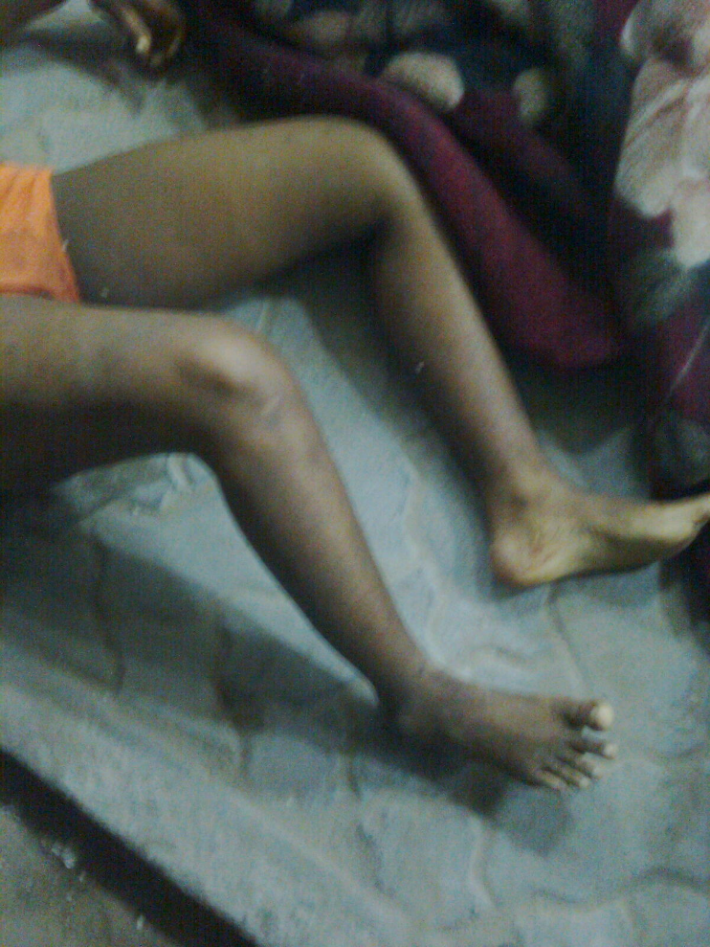
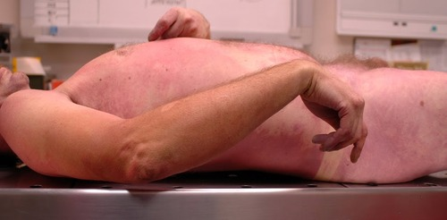

Slide 25
Factors that affect when rigor mortis sets in and how long it lasts
Ambient temp –
cooler the body, slower the onset
warmer the body, faster the onset
Person’s weight –
Body fat stores extra oxygen, will slow down onset
Type of clothing
Presence of clothing speeds onset
Naked bodies slow onset

Slide 26
Factors that affect when rigor mortis sets in and how long it lasts
Illness –
Fever –
Hypothermia –
Level of physical activity shortly before death
Exercise or struggling will increase onset rate
Sun exposure
Direct sunlight makes body warmer – increases onset rate

Slide 27
Algor Mortis
Means “death heat”
Thermometer inserted into liver as standard
Timeline:
0-12 hours after death: 1.4°F per hour
> 12 hours after death: 0.7° F per hour until reaching surrounding temp
Factors affecting heat loss:
Cooler environment – loses heat faster
More body fat, clothing – loses heat slower

Slide 28
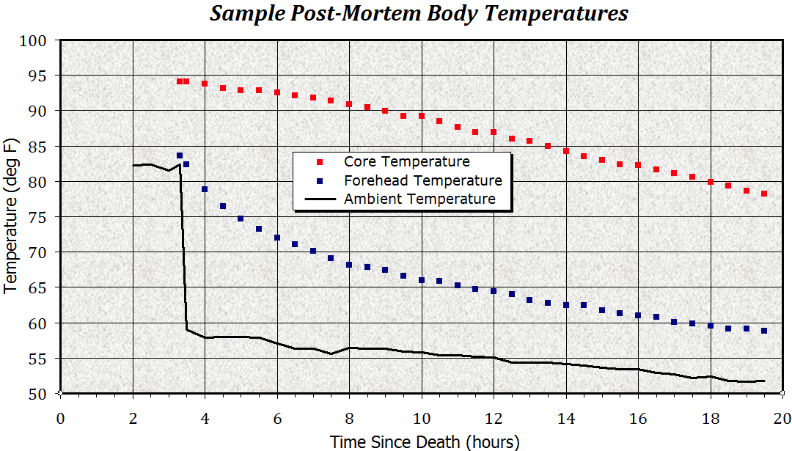

Slide 29
Other Factors also Used for Time of Death
Stomach Contents
Potassium present ocular fluid

Slide 30
Stages of Decomposition
Within two days after death: Initial Decay
Cell autolysis begins.
Green and purplish staining occurs from blood decomposition.
Skin takes on a marbled appearance.
Face becomes discolored.
After four days: Putrefaction
Skin blisters.
Abdomen swells with carbon dioxide (released by bacteria living in the intestines).

Slide 31
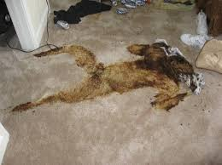
Stages of Decomposition
Within six to ten days: Putrefaction
Corpse continues to bloat with CO₂ as bacteria continue to feed on tissues
Eventually, gas causes chest and abdominal cavities to burst and collapse.
Fluids begin to leak from body openings as cell membranes rupture
Eyeballs and other tissues liquify
Skin Sloughs off

Slide 32
Stages of Decomposition Named!
Initial Decay – 0-3 days
Putrefaction – 4-10 days
Black Putrefaction – 10-20 days
Very strong odor
Parts of flesh appear black
Gases escape and corpse collapses
Butyric Fermentation – 20-50 days
Corpse is beginning to dry out
Most of flesh is gone
Dry Decay – 50 days or more
Corpse is almost dry
Further decay is slow due to lack of moisture

Slide 33
Factors that affect Speed of Decomposition
Age
Young decompose faster than elderly
Size of body
Overweight people decompose faster than smaller people
Temperature
Naked bodies decompose faster than clothed bodies
Lower, extremely high temps preserve corpses
Lower temps prevent bacterial growth, slow decomposition
Decompose fastest – 70 to 99˚F
Environment
Bodies decompose more quickly in air (oxygen rich)
More slowly in water, or buried

Slide 34
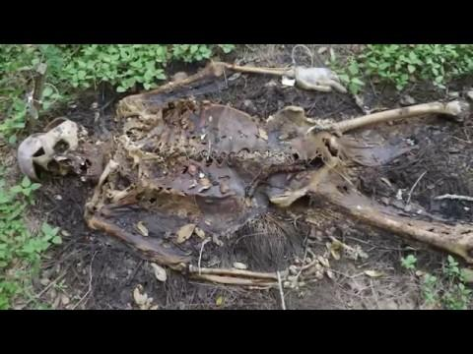

Slide 35
Stop Here for Today

Slide 36
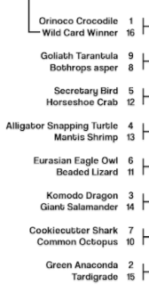
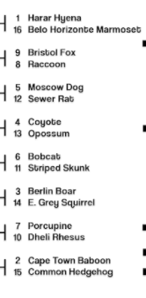
Thursday 3/22
Pick up an article (pg 36) and start reading & answering the questions

Slide 37
13 Secrets of Forensic Entomologists
Why are flies the true heroes of the field? What are they specifically attracted to?
What is a postmortem interval and how can flies be used to calculate it?
What could the absence of flies/larva on a body mean?
Why wouldn’t the forensic entomologists want to know if the death is natural or criminal?
How could drugs affect larval development?
How did the case of missing Mindy Tran help the field of forensic entomology as a whole?
How does the colonization pattern of a body help determine any wound patterns?
Why is the CSI effect a dangerous thing?

Slide 38
Forensic Entomology

Slide 40
Forensic Entomology
Forensic Protocol to Collect Insect Evidence:
On Body
Above Body
Below Body
Surrounding Environment

Slide 41
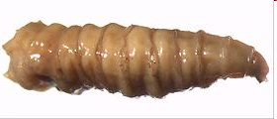
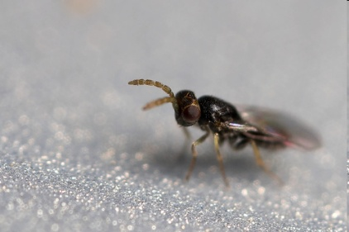
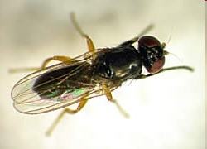
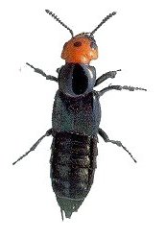
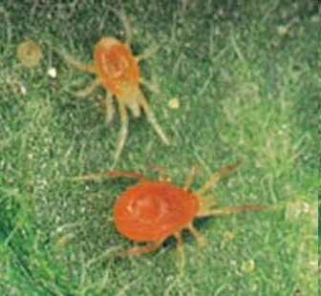
Common Insects of Decomposition
Any insect containing maggot stage of life
Most common is blow fly
Tiny wasps – lay their eggs
Larvae live inside maggots as parasites
Cheese Skippers
Attracted to seeping bodily fluids
Mites and Beetles
Favor drier conditions

Slide 42
Life Cycle of Blow Fly
Egg
Three Larval Stages (aka instar)
Early and late pupal stage
Adult

Slide 43
Stage | When first appears | Stage Duration | Characteristics
Egg | Soon after death | 8 hours | Found in moist, warm areas of body. Mouth, ears, anus
Larva 1 (Instar 1) | 1.8 days | 20 hours | 1 spiracle slit near anus Thin body
Larva 2 (Instar 2) | 2.5 days | 15-20 hours | 2 spiracle slits near anus Starts feeding
Larva 3 (Instar 3) | 4-5 days | 36-56 hours | 3 spiracle slits near anus Fat body
Pre-pupa | 8-12 days | 86-180 hours | Larvae start to migrate away from body
Early and late pupa stages | 18-24 days | 6-12 days | Immobile, doesn’t feed Changes to dark brown
Adult | 21-24 days | Several weeks | Hatched from larvae Immobile for first few hours

Slide 44
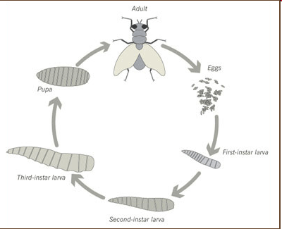
Time of Death and Blow Fly Stage
If a corpse contains blowfly eggs the approximate time of death would be 24 hours or less.
If a corpse contains third-stage larvae, time of death is approximately 4-5 days.
If a corpse contains pupae, time of death would be approximately 18-24 days.

Slide 45
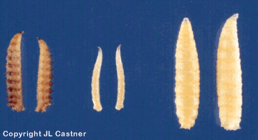
Factors that affect Insect Development
Temperature
Moisture
Wind
Time of day
Season
Exposure to elements
Variations among individual insects
Use of insects to predict time of death is only an estimate!
All environmental variations must be recorded at time of collection!!!!!

Slide 46
Accumulated Degree Hours (ADH)
Preserve some insects from the crime scene so you know exactly how old they are at the time of discovery of the body.
At the crime lab, raise some of the insects from the crime scene in the same conditions of those at the crime scene.
Record the length of time for development under the specific conditions found at the crime scene.
Compare the insects raised at the crime lab to those found at the crime scene.

Slide 47
More….
Other forensic uses for entomology include:
If insects from another region are found, body was most likely moved

Slide 48
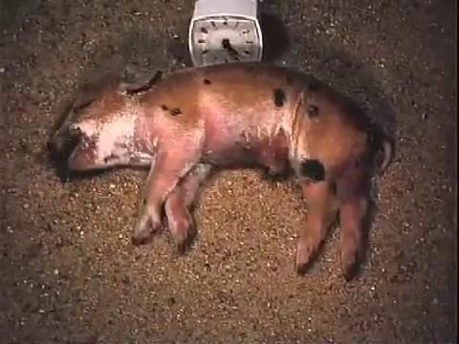

Slide 49
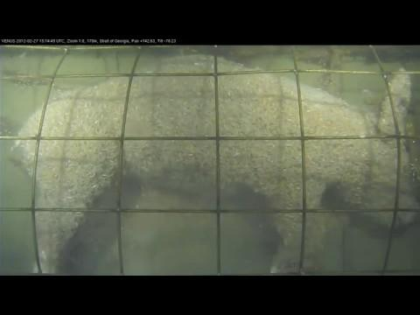

Slide 50
Summary
Manner of death refers to how the death occurred.
Cause of death refers to what led to the death
Mechanism of death refers to the specific bodily function resulting in death.
Several things can be used in determining time of death including:
Livor mortis, rigor mortis, algor mortis, stomach contents, stages of decomposition, and entomology

Slide 52
