Slide 1
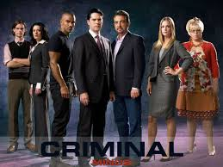
Criminal Profiling

Slide 2
Introduction—Vocabulary
Criminal profiler—a person who infers the personality and characteristics of a suspect based on information gathered from a crime scene
Modus operandi (MO)—also referred to as the method of operation, a recognized pattern of behavior in the commission of a crime

Slide 3
Introduction—Vocabulary
Signature—something unusual or specific left at the crime scene by the perpetrator
Victim—person who has experienced harm, injuries, loss, or death
Victimology—the study of victims affected by crime, accidents, or natural disasters

Slide 4
Introduction
Criminal profilers study evidence collected and analyzed by crime-scene investigators to formulate a hypothesis about a perpetrator’s
Age
Personality
Lifestyle
Social environment

Slide 5
Modern Day Profiling
Forensic psychiatrist
Interviews criminals and suspects
Evaluates personal history
Administers personality tests
Presents an opinion as testimony in court
James Brussel, 1950s, viewed profiling as a diagnostic tool, bridging the gap between criminal investigators and forensic psychiatrists

Slide 6
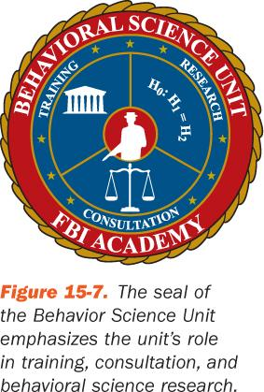
Modern Day Profiling
Howard Teten—created a criminal profiling division in 1970 for the FBI
Jack Kirsh, an FBI agent, opened the FBI’s Behavioral Science Unit (BSU)
BSU is now directed by the National Center for the Analysis of Violent Crime (NCAVC)

Slide 7
Stages of the Profiling Process
Input
Decision process models
Crime assessment
Criminal profile
Investigation
Apprehension
The logic is that the way a person thinks guides his or her behavior.

Slide 8
1 – Input
Collecting evidence (for example)
Placement of the victim and weapon(s)
Body position
Blood splatter
Condition of surroundings
History of the victim
Employment and reputation
Social habits
Hobbies and interests
Autopsy report

Slide 9
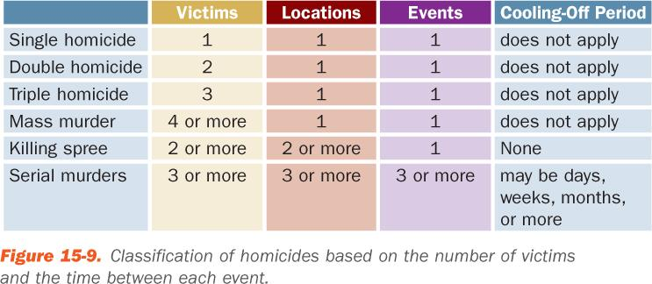
2 – Decision Process Models
Classifying the crime
Determining motives
Risk level of the victim

Slide 10
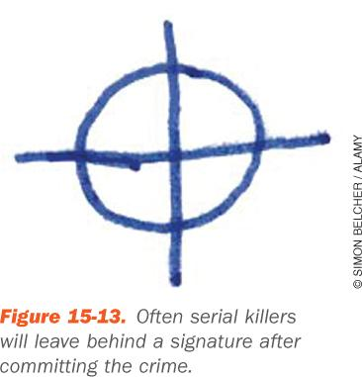
3 – Crime Assessment
Motivation behind the crime
Premeditated and planned?
Impulsive and no plan?
Modus Operandi— the method of operation
Signature—repeating a habit at each crime scene

Slide 11
4 – Criminal Profile
A typical profile includes estimates of:
Race
Sex
Physical characteristics
Habits
Values and beliefs
Compare the profile with the decision process models (stage 2) and reconstruction of the crime scene

Slide 12
5 – Investigation
Begins after profiler submits written report
Seek and evaluate suspects that match the profile

Slide 13
6 – Apprehension
Apprehend
Interview
Interrogate
Arrest

Slide 14
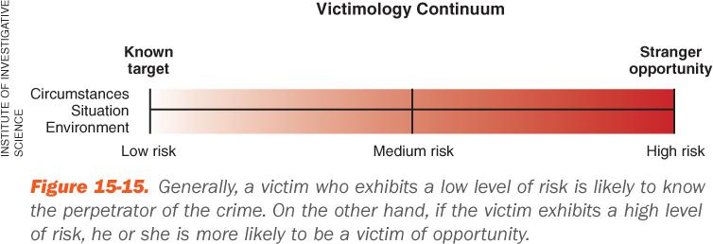
Victimology (Obj 15.4, 15.5, 15.6)
A victim is a person who has experienced harm, injuries, loss, or death.
Victimology is the study victims who have been affected by crime, accidents, or natural disasters.

Slide 15
Victim Risk
Assessment is very subjective

Slide 16
Victim Risk
All risks are considered from the perspective of the victim’s age, job, and criminal background.
Aggressive nature
Impulsive
Anxious
Passive
Thrives on attention
Self-inflicted injuries
Poor self-image
Negative
Exhibits addictive behaviors

Slide 17
Victimology Assessment
At the crime scene
Did the victim know the perpetrator?
Does the victim suspect anyone in particular and why?
Has the victim reported similar or other crimes in which he or she was the victim?
Is the victim carrying a weapon? Does the victim own a weapon?
Has the victim been in any other police reports in the past?

Slide 18
Victimology Assessment
Forensics and profiling working together:
What are some of the victim’s general physical characteristics, including eye color, hair color, weight, and ethnicity?
Where does the victim work and what is his or her work schedule?
Does the victim have a criminal history? If so, investigators will ask the victim to explain.
What is the victim’s daily routine?

Slide 19
Victimology Assessment
Working together (cont’d):
What is the contact information of the victim’s family members, friends, and coworkers?
What is the victim’s medical history, including mental health records?
What medications is the victim taking?
What is the victim’s education level?
Where does the victim live and with whom?
Create a timeline of events

Slide 20
Geographic Profiling

Slide 21
You have two minutes to draw a map of Irvine.

Slide 22
Geographical profiling
A set of techniques for making inferences about crime and criminals from the location and timing of offences.

Slide 23
Crime mapping
Plot the crimes on the map then decide...
How many offenders do you think are responsible and why?
What other suggestions can you make about the offender(s)?

Slide 24
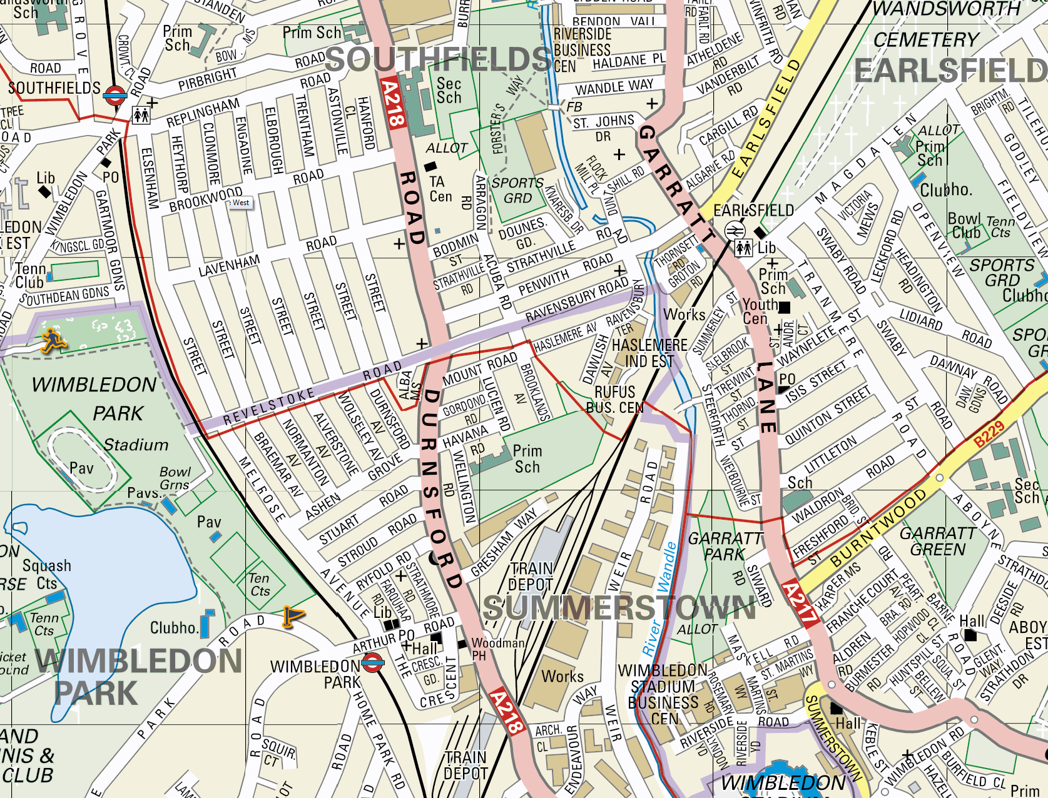
Crime mapping
Source: streetmap.co.uk

Slide 25
Crime mapping
Source: streetmap.co.uk

Slide 26
Offence clusters

Slide 27
Crime mapping
Source: streetmap.co.uk

Slide 28
Source: streetmap.co.uk

Slide 30
Routine activity theory
Crimes occur when three circumstances coincide:
A motivated offender
A suitable (and vulnerable) victim
Absence of a capable guardian
Criminal offences are an extension of the offender’s normal activities, so will occur in places the offender makes regular use of

Slide 31
Circle theory of environmental range
A circle drawn to encompass all the crimes in a series is likely to contain the offender’s base (Canter & Larkin, 1993).

Slide 32
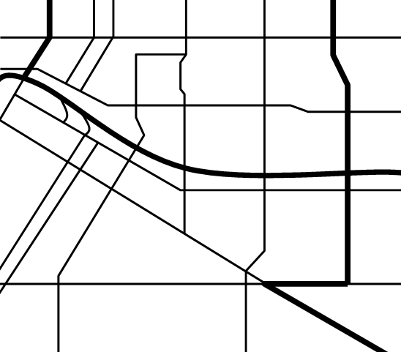
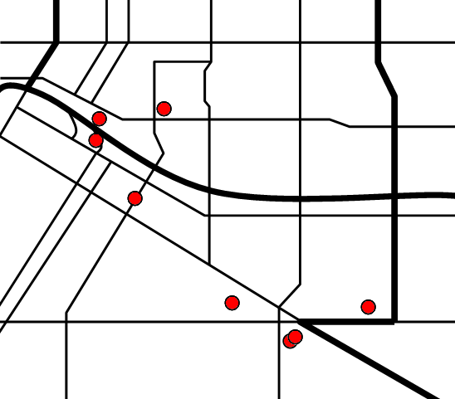
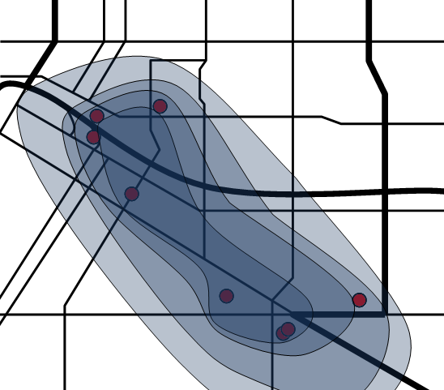
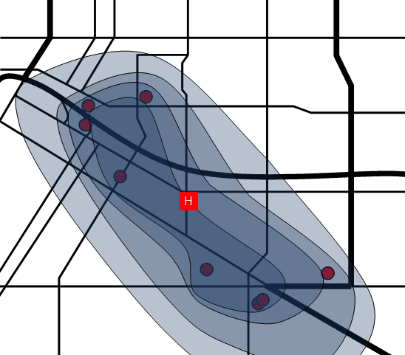
Dragnet analysis

Slide 33
Timing of offences
Information about geographical location of crimes becomes more useful when combined with information about when offences occurred.

Slide 34
Crimes around Manchester University
Street robbery
Burglary
J F M A M J J A S O N D
How can we explain the fluctuations in different crimes over the year?

Slide 35
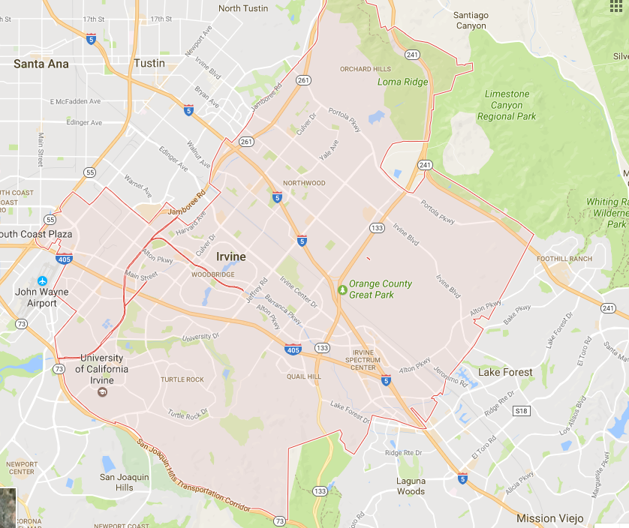
Mental maps
How accurate is your map of Irvine?
How does your map reflect your experiences and perspective?

Slide 36
Mental maps
Individuals construct mental maps of the areas they know.
These are not absolutely accurate. They embody the person’s experience and perspective on the area.
The distribution of linked offences may reflect the offender’s mental map of the area

Slide 37
How many different ways might geographical profiling contribute to police work?
What issues may make geographical profiling difficult and/or misleading?

Slide 38
Typological Profiling

Slide 39
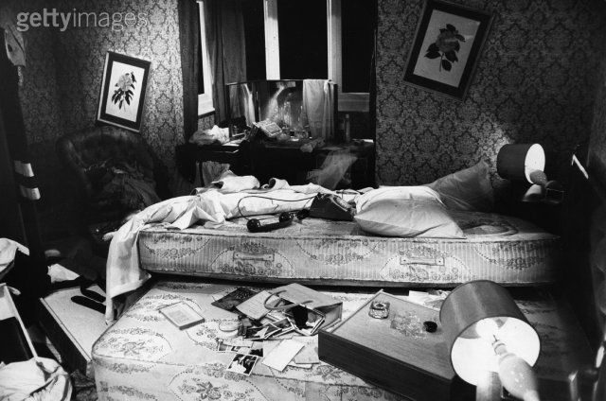
What does this crime scene tell you about the offender responsible?

Slide 40
Two important ideas
Behavioural evidence
Things that tells us how an offender went about committing a crime
Criminal consistency
The idea that a person’s behaviour at a crime scene is consistent with their behaviour in other contexts

Slide 41
Typological offender profiling
Developed by the US Federal Bureau of Investigation (FBI) in the 1970s and 1980s.
Key ideas:
There are different types of offender
Behavioural evidence can tell us which type of offender committed a crime
Knowing an offender’s type allows us to predict other things about him
Generally used in cases of serial violence against strangers esp. sexual or ‘bizarre’

Slide 42
FBI profiling process
Data assimilation
Data compiled from police reports, post mortems, crime scene photos etc.
Crime classification
Profilers decide whether the crime scene is organised or disorganised
Profile generation
Offender’s physical, demographic and behavioural characteristics
Crime reconstruction
Hypotheses about crime sequence, offender & victim behaviour etc.

Slide 43
Types of crime scene
 | Organized | Disorganized
General approach | Planned and controlled | Unplanned and chaotic
Weapons | Brought to the scene | Improvised
Evidence | Destroyed or removed | Left at scene
Victim | Attempts to control | Little attempt at control
Offender | Unknown to victim Socially & sexually competent Normal/high intelligence Angry/depressed | Possibly known to victim Socially & sexually inept Low intelligence Anxious/psychotic

Slide 44
Problems with typological profiling
What problems can you identify with the FBI’s approach to offender profiling?
Assumptions about stable types
Incomplete data
Subjective judgements
Small and unusual sample
Validity of methodology
Narrative & anecdotal evidence

Slide 45
Psychopathy Vs Reactive Offender
PSYCHOPATH
Self-concept: Invulnerable
Superior
Pre-emptive rights
Sees Others: Stupid
Inferior
Weak
Strategies: Manipulative
Violence
REACTIVE
Vulnerable
Fluctuates/unstable
Fragile rights
Hostile
Oppositional
The enemy
Inadequate problem solving
“Defensive” violence

Slide 46
Typology of Serial Killers
Visionary - kill because of visions - generally psychotic
Mission oriented - rid society of certain types of people e.g. prostitutes, runaway kids, racial group etc
Hedonistic - "thrill seekers" & lust killers
Power/Control orientated - pleasure is not sexual but power - often killing when the victim abandons hope of survival and acquiesces
Notes:
SK often associated with the Paraphilias (devaint sexual arousal & fetishes) and as a conbsequence some emphasize the importance of fantasy in creating the conditions for SK motivation:
Holmes and DeBurger Typology [1988] based on assumption that it is psycho-genic [psychologically rewarding not insanity or gain], motives are evident only to the killer in an "intrinsic locus of motives" see the usefulness of the techniques of neutralisation idea and other socio-psychological theories of crime causation as well.

Slide 47
FBI Psychological Profile of Lust Killers
Organized Killer
intelligent
masculine image
charismatic
socially capable
sexually capable
occupationally mobile
lives with partner
geographically mobile
harsh childhood discipline
controlled emotions
interested in media
model inmate
Disorganized Killer
below average IQ
socially immature
seldom dates
high school failure
unemployed father
lives alone
has secret hiding places
nocturnal
lives/works near crime
unskilled worker
behavior change
low interest in media
high anxiety during crime
Notes:
Disorganised killers often will behave predictably after murder and usually are more easily caught than -- go to the crime scene, attend funeral, keep a diary, mood changes, religious revival, change employment, write to newspapers about vicitms etc.

Slide 48
FBI Profile: Organized
Show signs of planning and evidence of control at the crime scene
Offenders are -
Intelligent
Socially skilled
Sexually competent
Live with a partner
Usually target strangers
Antisocial & psychopathic personality

Slide 49
FBI’s Approach to Offender Profiling: Disorganized
Unplanned and disorganized behavior & lack of control at the crime scene
Offenders are -
Low intelligence
Socially and sexually inept
Live alone
Severe mental illness
Likely have been suffered from physical or sexual abuse as a child
Frightened or confused state of mind

Slide 50
Four Stages of Crime: Serial Killers
Pre-crime Stage
Actual commission of crime
Disposal of body
Post-crime behavior

Slide 51
Investigation & Forensic Techniques
Solvability of serial killer crime depends on:
Quality of police interviews with witnesses
Circumstances that lead to the initial contact with the murderer
Circumstances that established probable cause to search & seize physical evidence
Quality of scene crime investigation
Quality of scientific analysis of physical evidence

Slide 52
Profile of Fire-setters
Learning problems
Poor school behavior
Absent parents
Lying
Fights with siblings
Disobedient
Pre-occupied & fascinated by fire
Impulsive
Unhappy dysfunctional family
Needs security & affection
Impatient
Poor concentration
Attention seeking
Peer influence
Notes:
Firesetting [juveniles] arson [adults] is considered by some psychologist as a good example of the connection to family dysfunction which is the essential pathology of poor socialisation. Hickey reports a US sudy of 1,200 juvenile firestarters [90% male] which found common psychological and behavioral problems and he argues this is the most persistent of deviant behaviours from childhood to adult whereas many childhood delinquency disappear with adulthood [but often this is because they can do those things they want to without breaking the law!!].

