Slide 1
17-2 Earth’s Early History

Slide 2
Formation of Earth
Earth is about 4.6 billion years old and was not “born” in a single event.
Pieces of cosmic debris were probably attracted to one another over about 100 million years.

Slide 3
Early Earth was very hot
Earth’s early atmosphere contained many toxic gasses and little or NO oxygen.
About 3.8 billions years ago, Earth’s surface cooled enough for water to remain a liquid.

Slide 4
The First Organic Molecules
In the 1950s chemists Stanley Miller and Harold Urey filled a flask with water, hydrogen, ammonia, and methane (WHAM) and passed electric sparks through the mixture.
After several days, amino acids formed!!

Slide 5
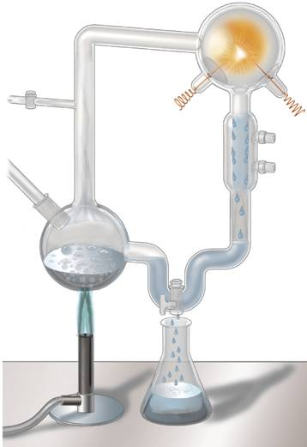
The First Organic Molecules
Miller and Urey’s Experiment
Mixture of gases simulating
atmosphere of early Earth
Spark simulating
lightning storms
Condensation
chamber
Water
vapor
Cold water cools chamber, causing droplets to form.
Liquid containing amino acids and other organic
compounds
Notes:
Miller and Urey produced amino acids, which are needed to make proteins, by passing sparks through a mixture of hydrogen, methane, ammonia, and water. This and other experiments suggested how simple compounds found on the early Earth could have combined to form the organic compounds needed for life.

Slide 6
The First Organic Molecules
Miller and Urey's experiments suggested how mixtures of the organic compounds necessary for life could have arisen from simpler compounds present on a primitive Earth.
Although their simulations of early Earth were not accurate, experiments with current knowledge yielded similar results.

Slide 7
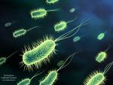
The Puzzle of Life's Origin
The Puzzle of Life's Origin
Evidence suggests that 200–300 million years after Earth had liquid water, cells similar to modern bacteria were common.

Slide 8
Free Oxygen
Free Oxygen
Microscopic fossils, or microfossils, of unicellular prokaryotic organisms resembling modern bacteria have been found in rocks over 3.5 billion years old.
These first life-forms evolved without oxygen.

Slide 9
Free Oxygen
About 2.2 billion years ago, photosynthetic bacteria began to pump oxygen into the oceans.
Next, oxygen gas accumulated in the atmosphere.

Slide 10
Origin of Eukaryotic Cells
The Endosymbiotic Theory
The endosymbiotic theory proposes that eukaryotic cells arose from living communities formed by prokaryotic organisms.

Slide 11
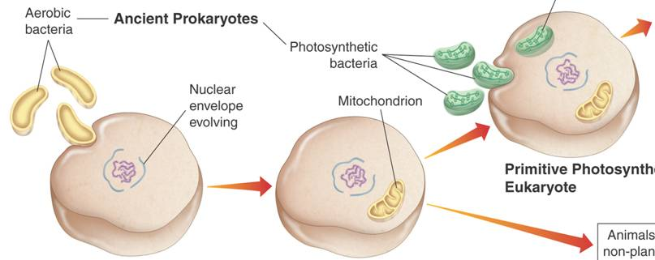
Origin of Eukaryotic Cells
Endosymbiotic Theory
Ancient Prokaryotes
Chloroplast
Plants and plantlike protists
Aerobic
bacteria
Photosynthetic bacteria
Nuclear envelope
evolving
Mitochondrion
Primitive Photosynthetic
Eukaryote
Animals, fungi, and
non-plantlike protists
Ancient Anaerobic
Prokaryote
Primitive Aerobic
Eukaryote
Notes:
The endosymbiotic theory proposes that eukaryotic cells arose from living communities formed by prokaryotic organisms. Ancient prokaryotes may have entered primitive eukaryotic cells and remained there as organelles.

Slide 12
Sexual Reproduction and Multicellularity
Most prokaryotes reproduce asexually.
Eukaryotic cells began to reproduce sexually which led to greater genetic variety.
A few hundred million years after the evolution of sexual reproduction, multicellular organisms began to develop.

