Slide 1
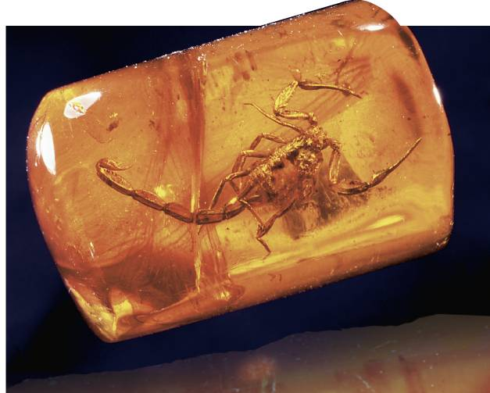
17-1 The Fossil Record

Slide 2
Fossils and Ancient Life
Paleontologists are scientists who study fossils.
The fossil record provides evidence about the history of life on Earth. It also shows how groups of organisms have changed over time.

Slide 3
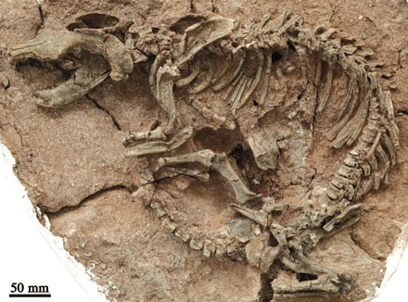
More than 99 percent of all the species that have ever lived on Earth are now extinct.

Slide 4
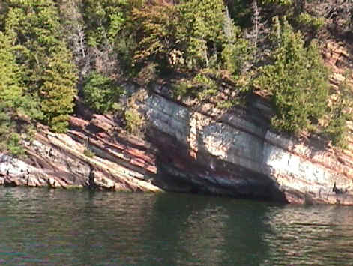
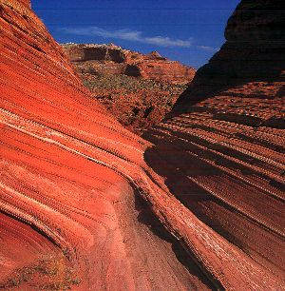
How Fossils Form
Most fossils form in sedimentary rock.

Slide 5
Fossil Formation:

Slide 6
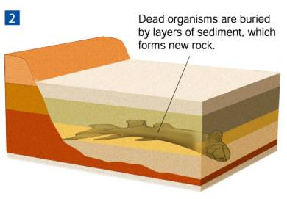

Slide 7
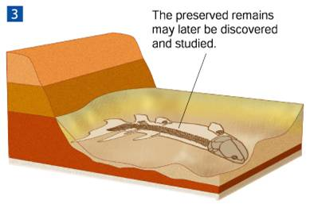

Slide 8
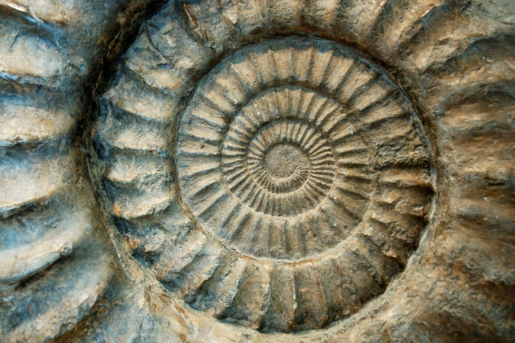
A fossil can be large and complete or small and incomplete.
There are many types of fossils
Fossilized eggs
Footprints
Fossilized bone
Imprints of leaves or shells
Fossilized animal droppings
Insects in amber

Slide 9
Interpreting Fossil Evidence
Paleontologist use fossil evidence to understand Earth’s past.
The age of a fossil can be determined by:
Relative Dating-Estimating a fossil’s age by comparing it to other fossils.
Radioactive Dating-Calculating the age of a fossil by the amount of radioactive isotope it contains.

Slide 10
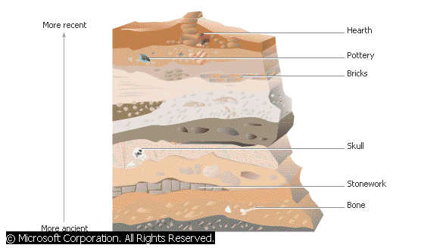
Relative Dating
In relative dating, the age of a fossil is determined by comparing its placement with that of fossils in other layers of rock.
Rock layers form in order by age—the oldest on the bottom, with more recent layers on top.

Slide 11
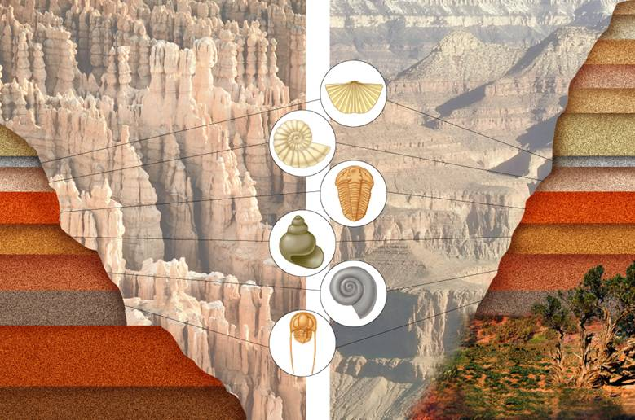

Slide 12
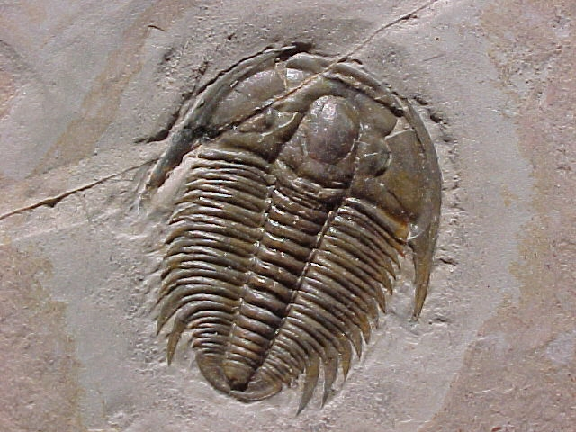
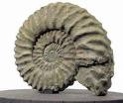
Index fossils are used to compare the relative ages of fossils.
An index fossil is a species that is recognizable and that existed for a short period but had a wide geographic range.

Slide 13
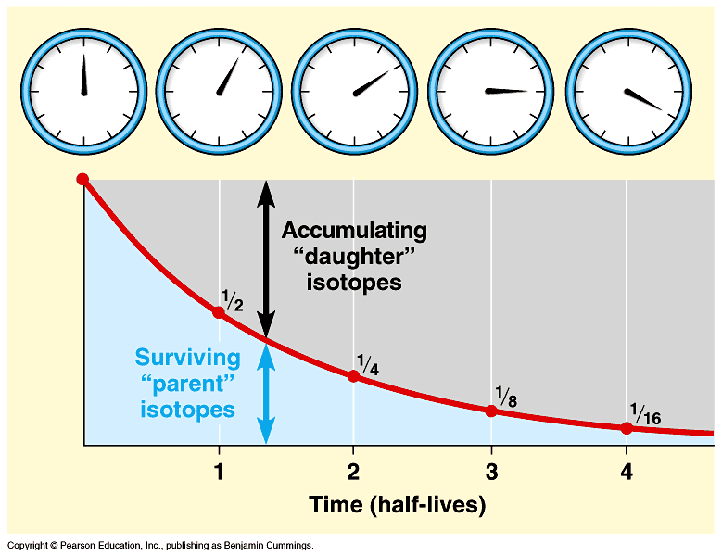
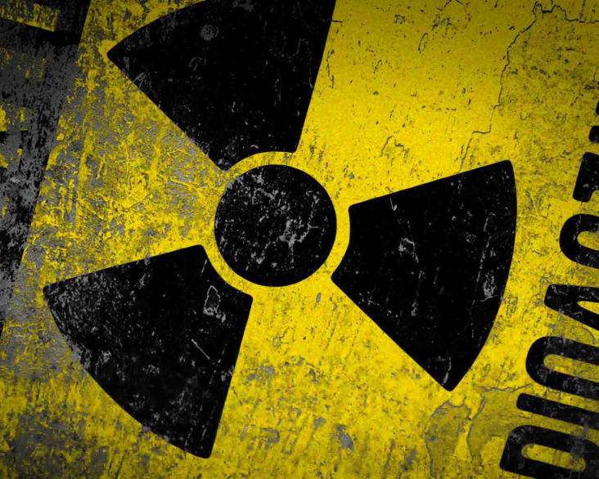
Radioactive Dating
Radioactive Dating is the use of half-lives to determine the age of a sample.
A half-life is the length of time required for half of the radioactive atoms in a sample to decay.

Slide 14
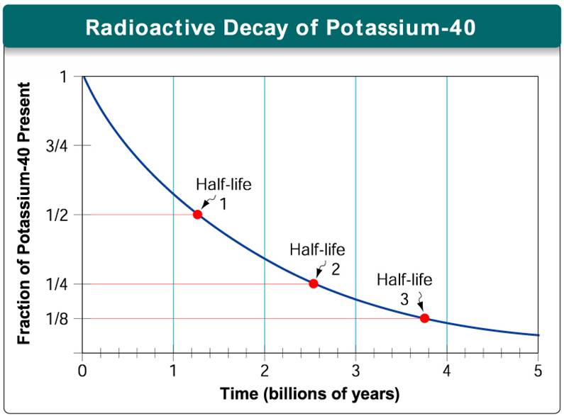

Slide 15
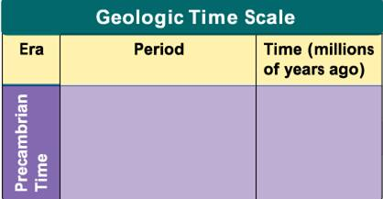
Geologic Time Scale
Scientists use several levels of divisions for geologic time.
Geologic time begins with Precambrian Time which covers 88% of Earth’s history.

Slide 16
Eras and Periods
Geologists divide the time between Precambrian time and the present into three eras:
Paleozoic Era
Mesozoic Era
Cenozoic Era
These eras are then subdivided into periods.

Slide 17
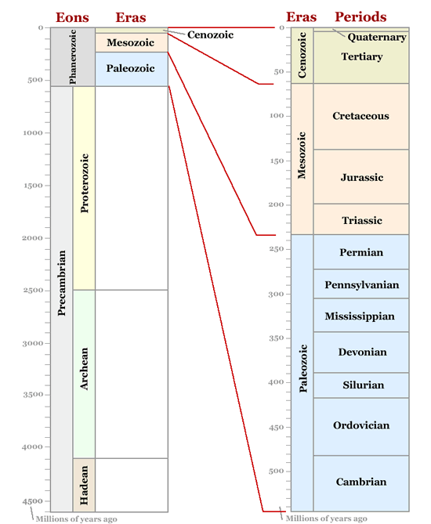

Slide 18
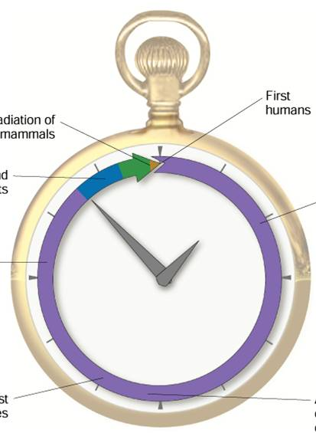
Geologic Time Scale
Clock Model of Earth’s History
Radiation of mammals
First humans
First land plants
First prokaryotes
First multicellular organisms
Cenozoic Era Mesozoic Era Paleozoic Era Precambrian Time
First eukaryotes
Accumulation of
atmospheric
oxygen
Notes:
Earth’s history is often compared to a familiar measurement, such as the twelve hours between noon and midnight. In such a comparison, notice that Precambrian Time lasts from noon until after 10:30 pm.

