Slide 1
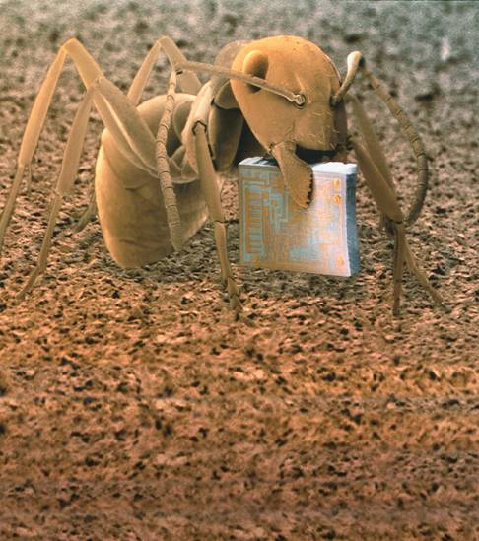
Honors Biology
1-1 What is Science?

Slide 2
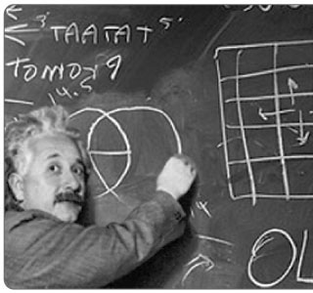
The goal of science is to investigate and understand, explain and make predictions about the natural world.
Scientists collect and organize information looking for patterns and connections that can be tested.

Slide 3
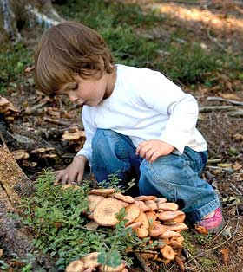
Thinking Like a Scientist
Scientific thinking begins with observation.
Observation is the process of gathering information about events or processes in a careful, orderly way.

Slide 4
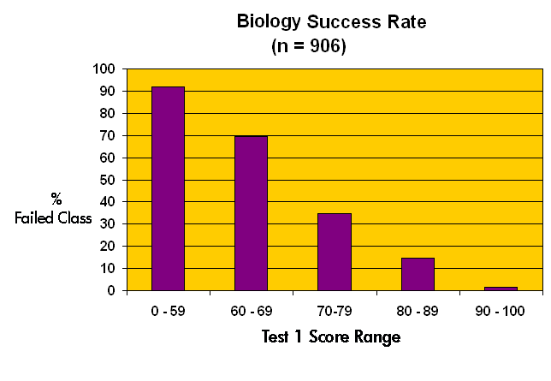
The information gathered from observations is called data.
Quantitative data: numbers and measurements
Qualitative data: descriptions

Slide 5
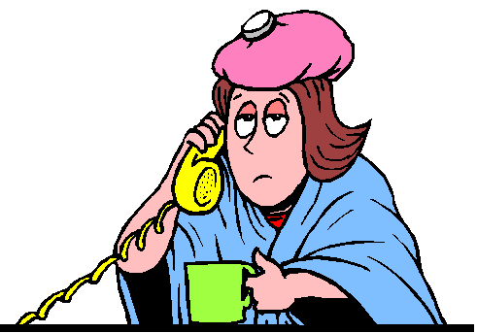
Scientists use data to make inferences.
An inference is a logical interpretation based on prior knowledge or experience.

Slide 6
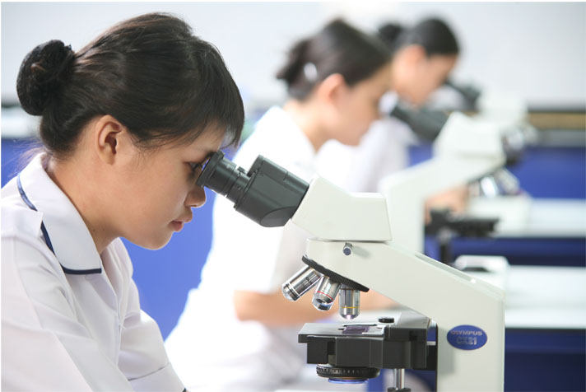
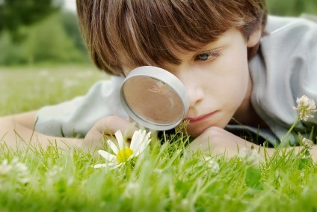
Explaining and Interpreting Evidence
A hypothesis is a proposed scientific explanation for a set of observations.
A hypothesis may be ruled out or confirmed.

Slide 7
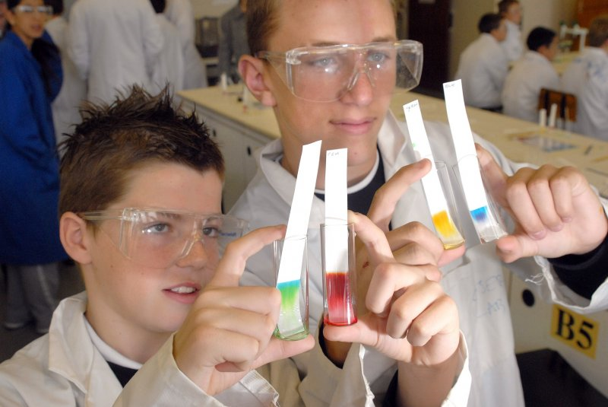
Hypotheses are tested by performing controlled experiments or by gathering new data.

Slide 8
Science as a Way of Knowing
Science is an ongoing process that involves:
asking questions
observing
making inferences
testing hypotheses

Slide 9
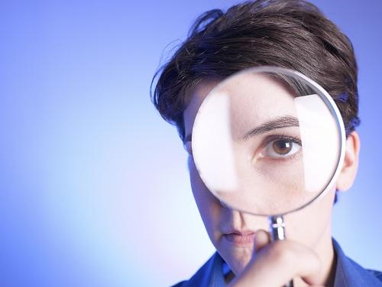
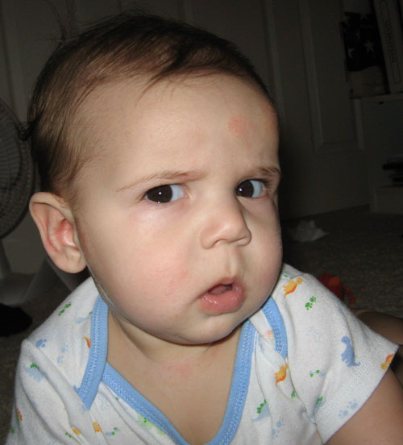
Scientific understanding is always changing.
Good scientists are skeptics who question both existing ideas and new hypotheses.

Slide 10
1-2 How Scientists Work

Slide 11
Designing an Experiment
The process of testing a hypothesis includes:
Asking a question
Forming a hypothesis
Setting up a controlled experiment
Recording and analyzing results
Drawing a conclusion

Slide 12
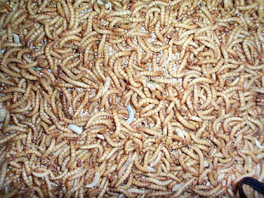
Asking a Question
Many years ago, people wanted to know how living things came into existence. They asked:
How do organisms come into being?

Slide 13
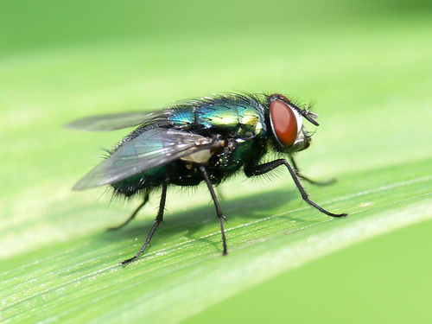
Forming a Hypothesis
One early hypothesis was spontaneous generation.
For example, most people thought that maggots spontaneously appeared on meat.
In 1668, Redi proposed a different hypothesis: that maggots came from eggs that flies laid on meat.

Slide 14
The next step is to test the hypothesis (experiment)
The best experiments test only a single variable: independent or manipulated variable. While all others are kept constant: controlled variables
Changes that result from the experimental variable are called dependent or responding variable.

Slide 15
Redi’s Experiment
Uncovered jars
Covered jars
Controlled Variables:
jars, type of meat,
Location, temperature,
time
Notes:
In a controlled experiment, only one variable is tested at a time. Redi designed an experiment to determine what caused the sudden appearance of maggots. In his experiment, the manipulated variable was the presence or absence of the gauze covering. The results of this experiment helped disprove the hypothesis of spontaneous generation.

Slide 16
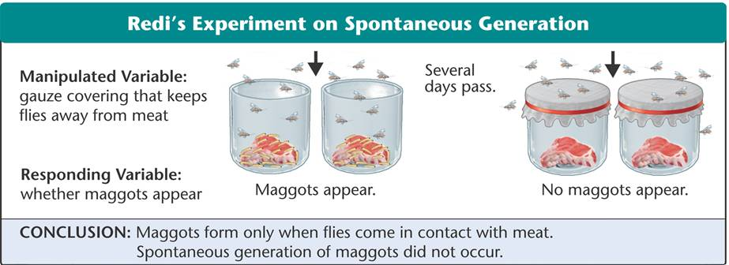
Redi’s Experiment
Manipulated Variable:
Gauze covering that keeps flies away from meat
Several days pass.
Responding Variable:
whether maggots appear
Maggots appear.
No maggots appear.

Slide 17
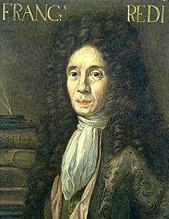
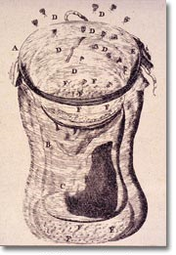
Drawing a Conclusion
Scientists use the data from an experiment to evaluate a hypothesis and draw a valid conclusion.

Slide 18
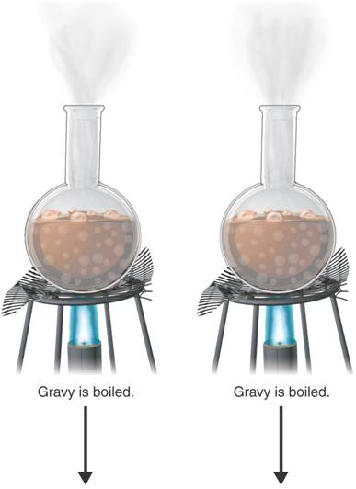
Spallanzani's Test of Redi's Findings
Gravy is boiled.
Gravy is boiled.
Notes:
Spallanzani’s experiment showed that microorganisms will not grow in boiled gravy that has been sealed but will grow in boiled gravy that is left open to the air. Interpreting Graphics What variable was controlled in this experiment?

Slide 19
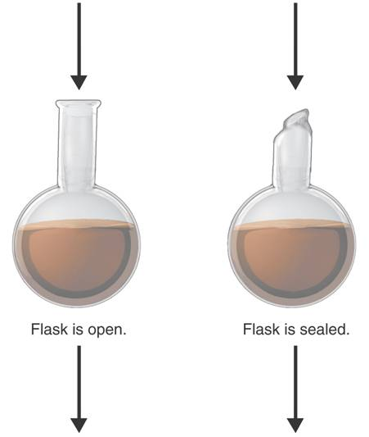
Spallanzani's Test of Redi's Findings
Flask is open.
Flask is sealed.

Slide 20
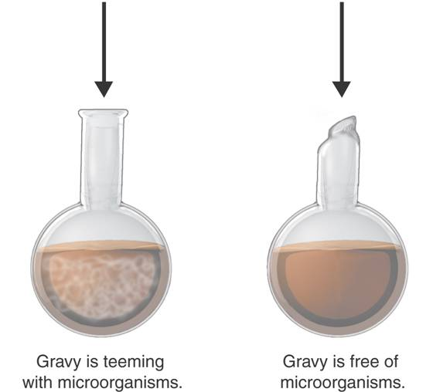
Spallanzani's Test of Redi's Findings
Gravy is teeming with microorganisms.
Gravy is free of microorganisms.

Slide 21
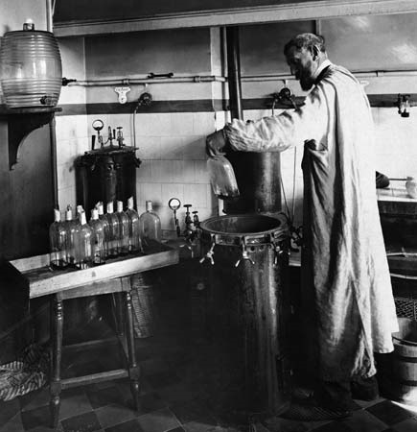
Pasteur's Test of Spontaneous Generation
Louis Pasteur conclusively disproved the hypothesis of spontaneous generation.
Pasteur showed that all living things come from other living things.

Slide 22
Pasteur’s Experiment
Broth is free of microorganisms for a year.
Curved neck is removed.
Broth is teeming with microorganisms.
Broth is boiled
Notes:
Pasteur’s experiment showed that boiled broth would remain free of microorganisms even if air was allowed in, as long as dust and other particles were kept out.

Slide 23
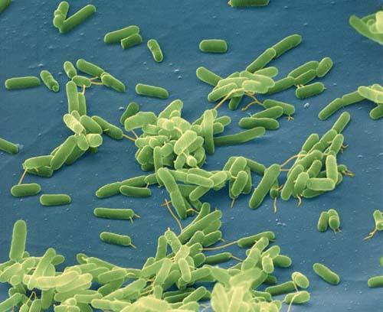
The Impact of Pasteur’s Work
Pasteur saved the French wine industry, which was troubled by unexplained souring of wine.
He began to uncover the nature of infectious diseases, showing that they were the result of microorganisms.

Slide 24
How a Theory Develops
As evidence from numerous investigations builds up, a hypothesis may become so well supported that scientists consider it a theory.
In science, the word theory applies to a well-tested explanation that unifies a broad range of observations.

